Slide 1
Hey: Download this and open it on your PC to see all the right colors & fonts.

Slide 2
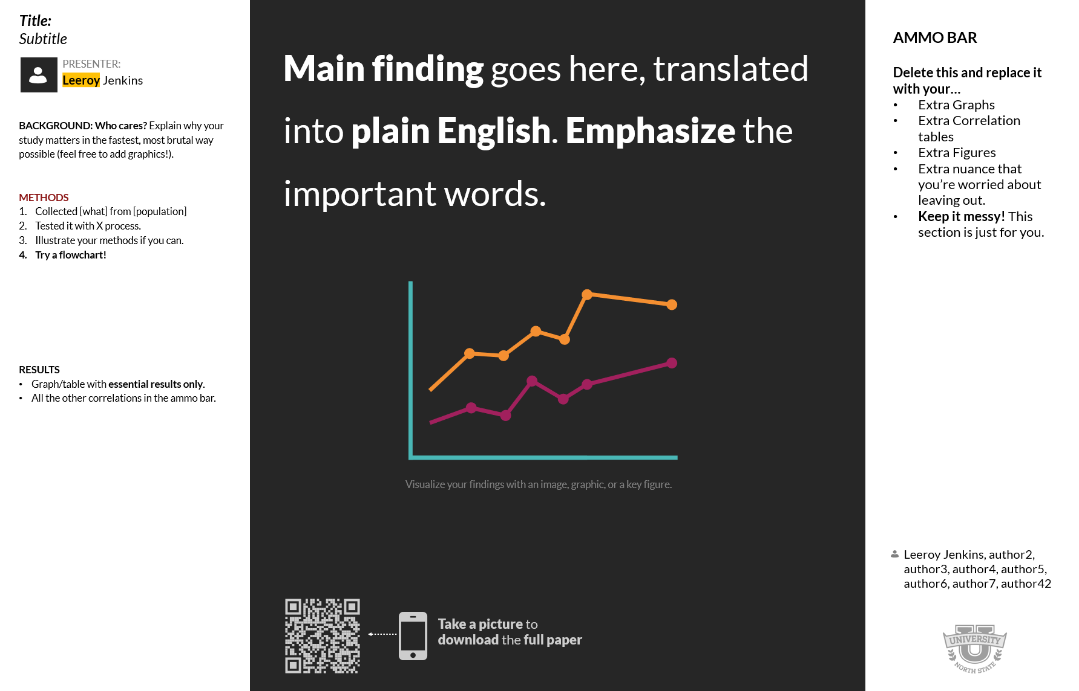
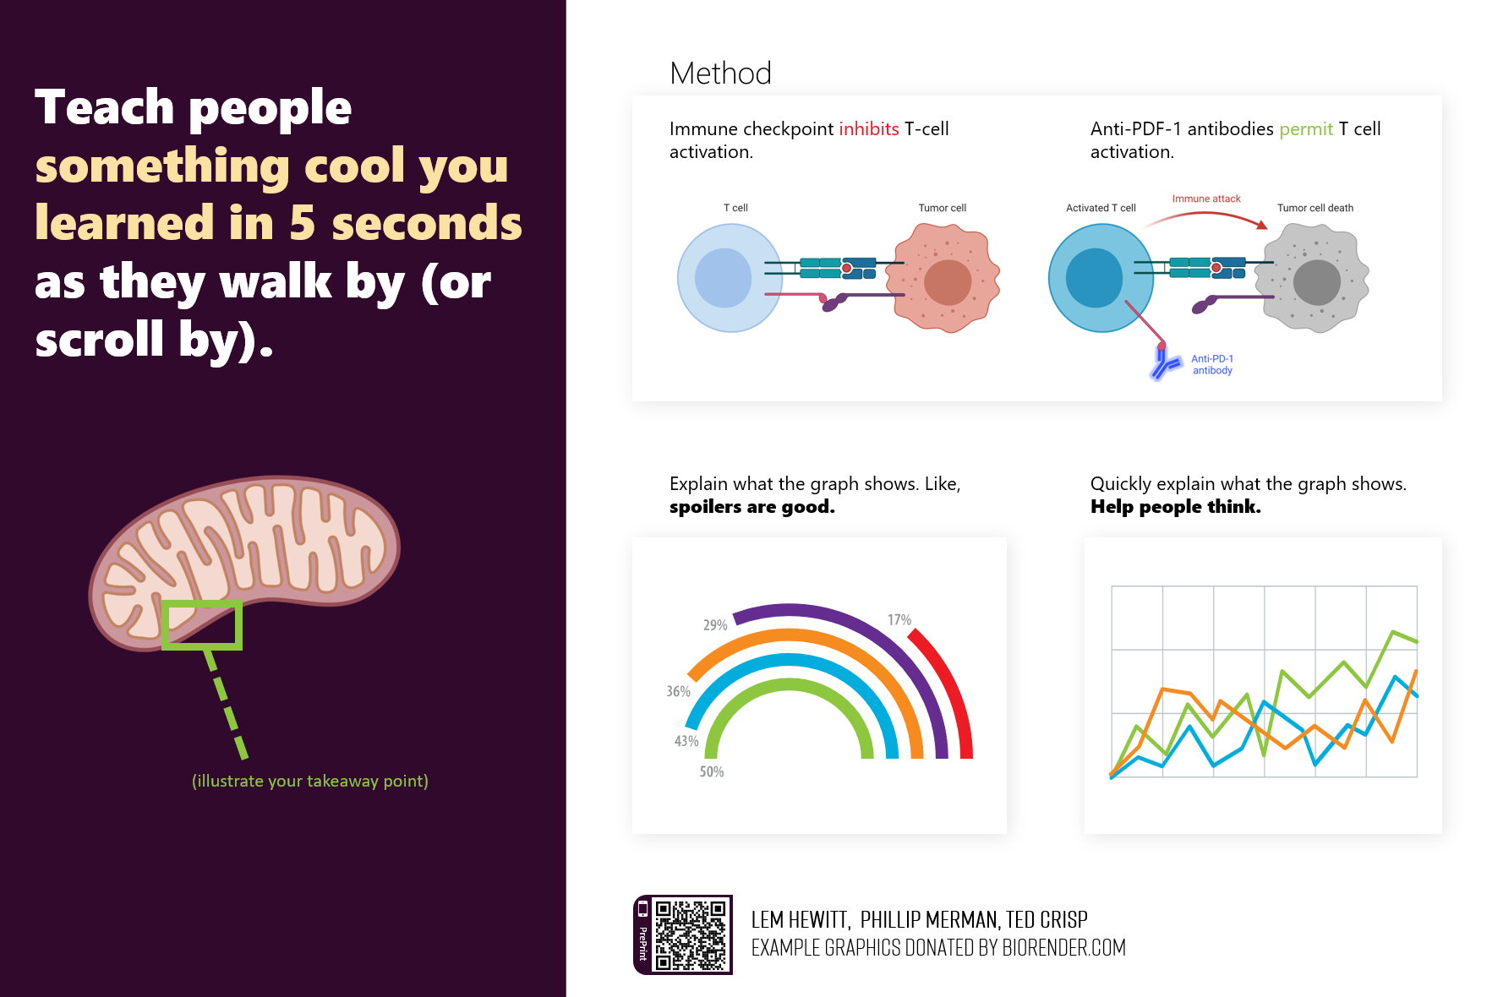
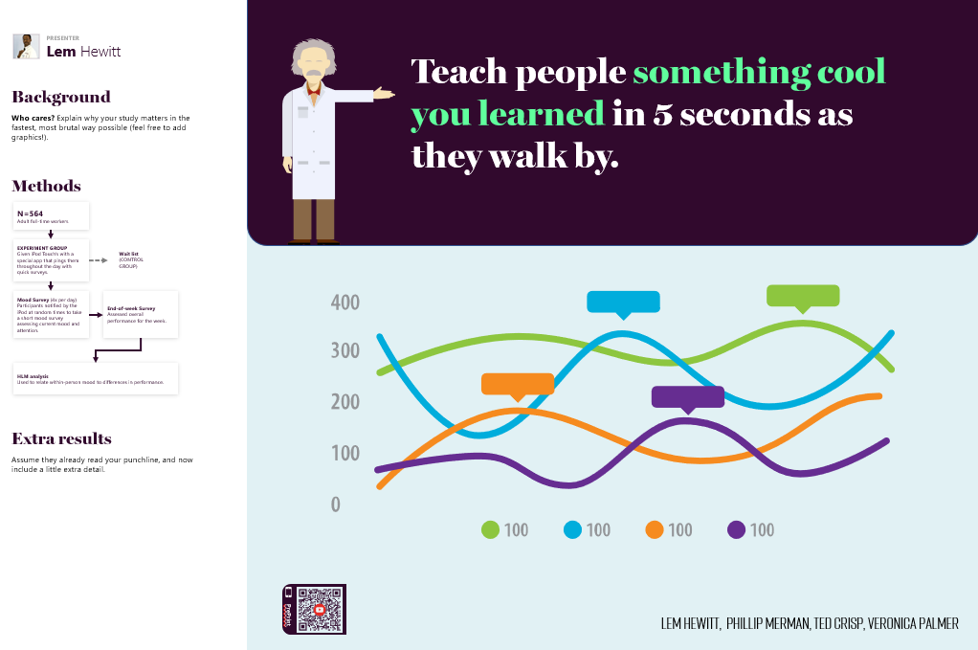
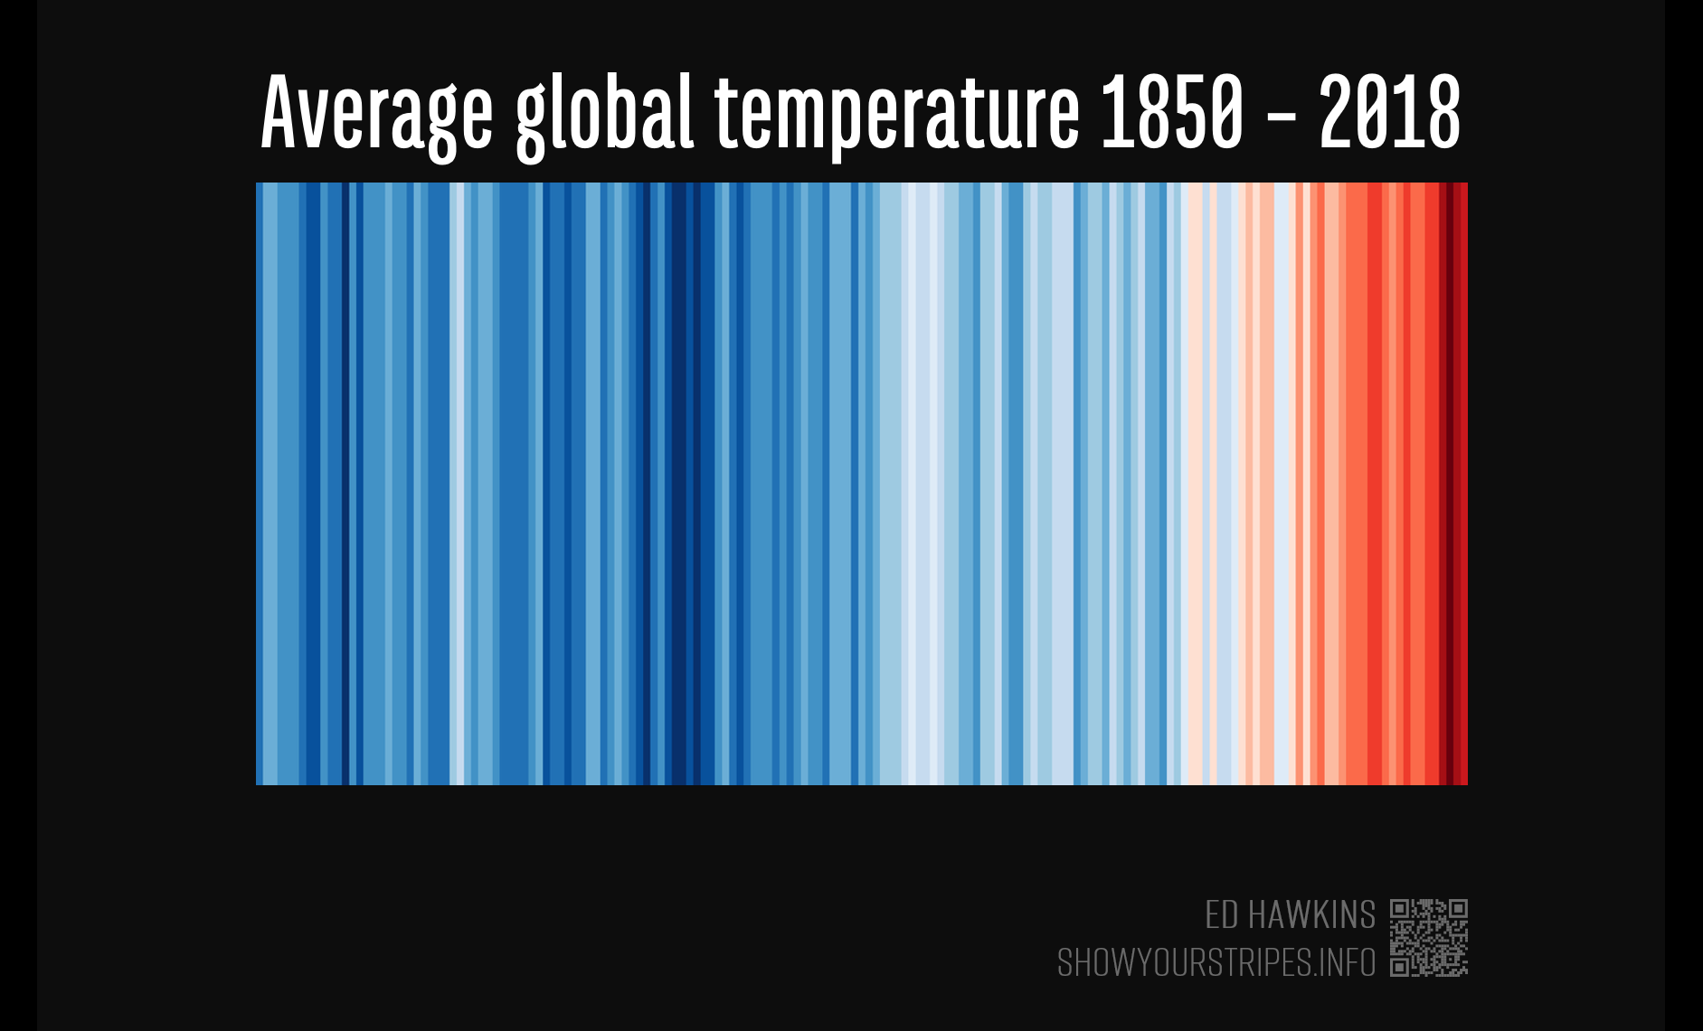
The #betterposter collection…
Original
Presenter
Figure Hero
Data Art

Slide 3
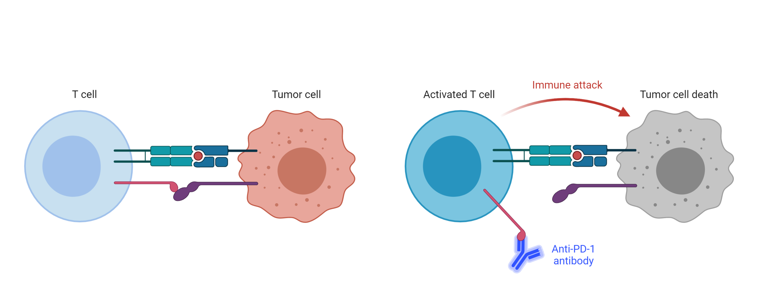

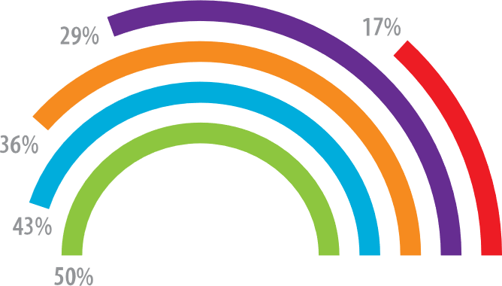
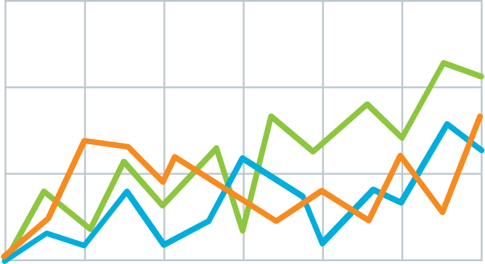

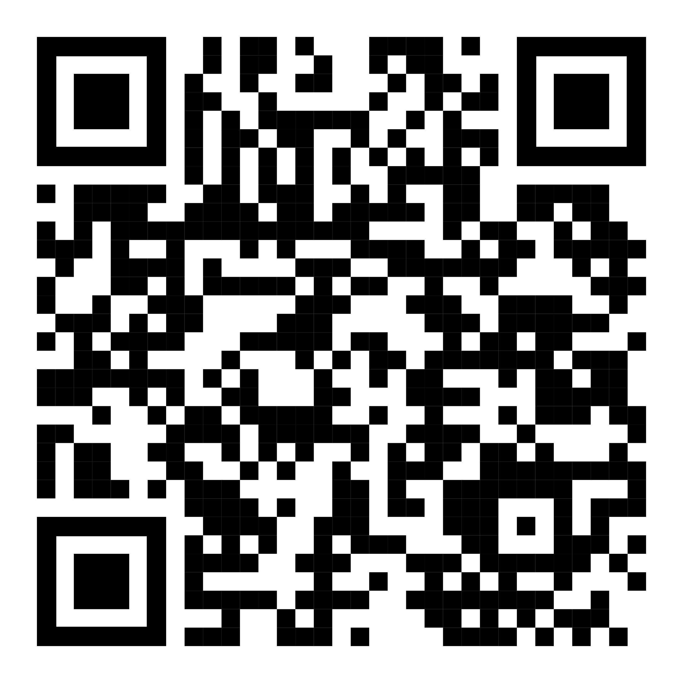
Method
Teach people something cool you learned in 5 seconds as they walk by (or scroll by).
v
Immune checkpoint inhibits T-cell activation.
Anti-PDF-1 antibodies permit T cell activation.
Explain what the graph shows. Like, spoilers are good.
Quickly explain what the graph shows. Help people think.
v
v
(illustrate your takeaway point)
LEM HEWITT, Phillip Merman, Ted crisp
EXAMPLE Graphics donated by biorender.com
PrePrint

Slide 4

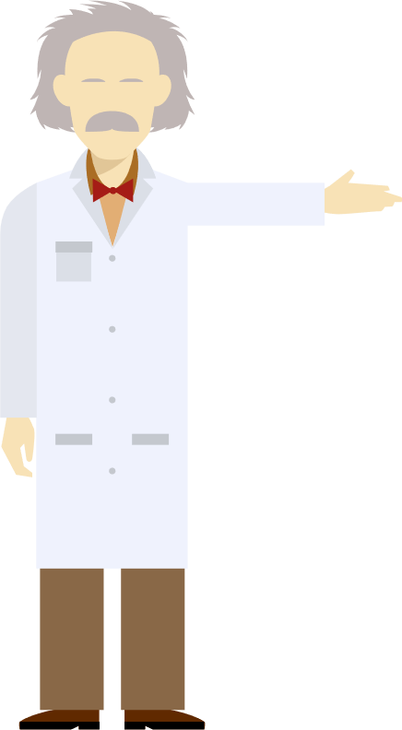
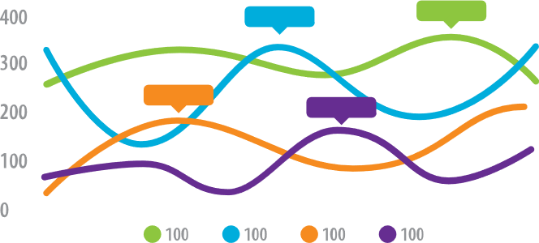

PRESENTER
Lem Hewitt
Teach people something cool you learned in 5 seconds as they walk by.
Background
Who cares? Explain why your study matters in the fastest, most brutal way possible (feel free to add graphics!).
Methods
N=564
Adult full-time workers
EXPERIMENT GROUP
Given iPod Touch’s with a special app that pings them throughout the day with quick surveys.
Wait list
(CONTROL GROUP)
Mood Survey (4x per day)
Participants notified by the iPod at random times to take a short mood survey assessing current mood and attention.
End-of-week Survey
Assessed overall performance for the week.
HLM analysis
Used to relate within-person mood to differences in performance.
Extra results
Assume they already read your punchline, and now include a little extra detail.
PrePrint
LEM HEWITT, Phillip Merman, Ted crisp, veronica palmer

Slide 5
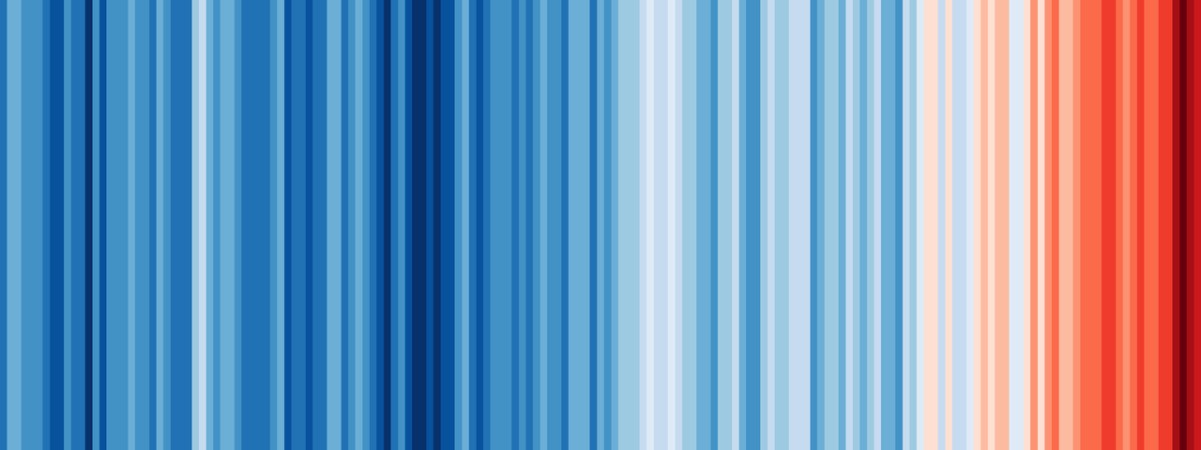

Average global temperature 1850 – 2018
ED HAWKINS
SHOWYOURSTRIPES.INFO

Slide 6
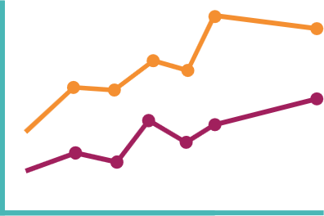


Main finding goes here, translated into plain English. Emphasize the important words.
Non-Cognitive Predictors of Student Success:
A Predictive Validity Comparison Between Domestic and International Students
Title:
Subtitle
AMMO BAR
Delete this and replace it with your…
Extra Graphs
Extra Correlation tables
Extra Figures
Extra nuance that you’re worried about leaving out.
Keep it messy! This section is just for you.
PRESENTER:
Leeroy Jenkins
BACKGROUND: Who cares? Explain why your study matters in the fastest, most brutal way possible (feel free to add graphics!).
METHODS
Collected [what] from [population]
Tested it with X process.
Illustrate your methods if you can.
Try a flowchart!
RESULTS
Graph/table with essential results only.
All the other correlations in the ammo bar.
Visualize your findings with an image, graphic, or a key figure.
Leeroy Jenkins, author2,
author3, author4, author5, author6, author7, author42
Take a picture to
download the full paper
Notes:
Notes:
In Powerpoint, click View > Guides
Keep text within gutter guides.
Author list: Don’t split names onto two lines (e.g., “Jimmy [break] Smith”). If that happens, use a new line, unless you need the space. Bold the first names of anybody who’s presenting in person.
Intro/methods/result: Do not drop below font size 28, but if you have extra space, jack up the font size until the space is full.
Do not use color in the sidebars except in graphs/figures. It’ll pull attention from the center and slow interpretation for passersby.

Slide 7

Add a key figure
Show-and-tell the best, most insightful part of your methods & data.
Example donated by @drElsje

Slide 8
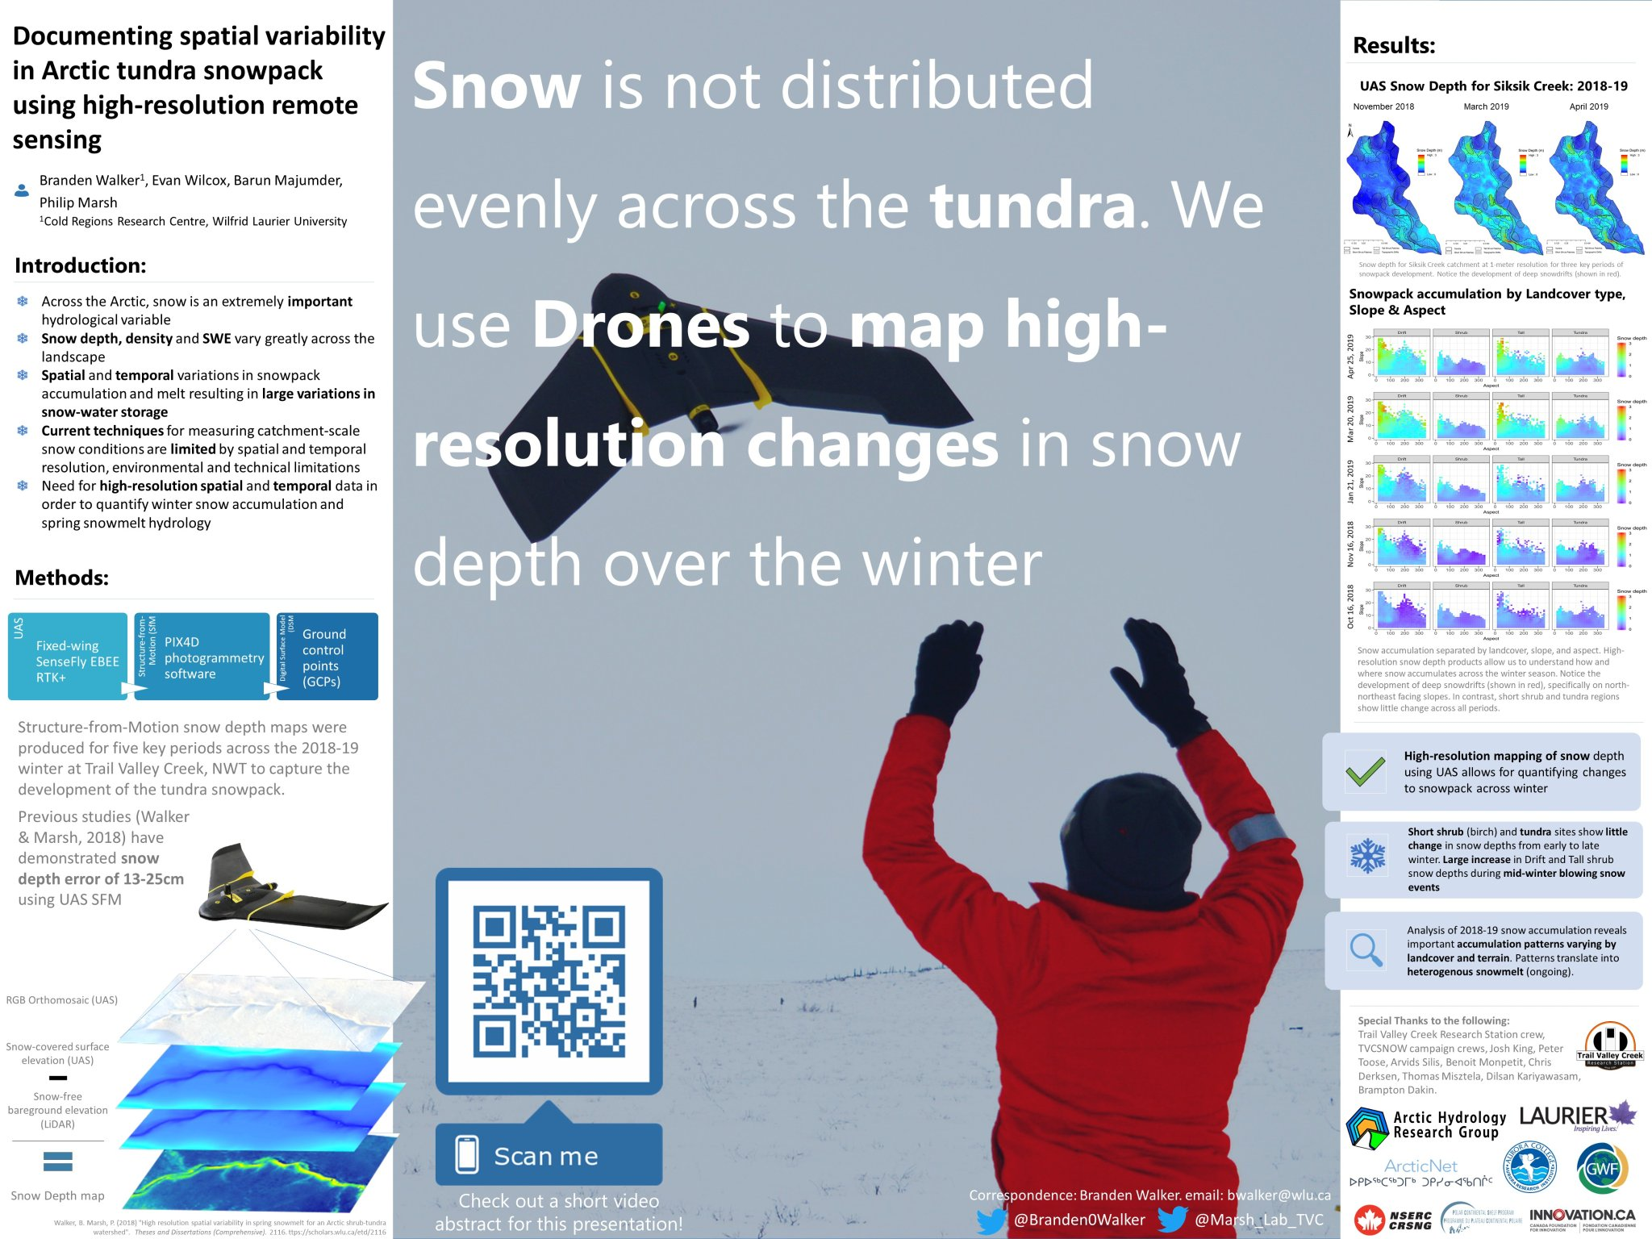
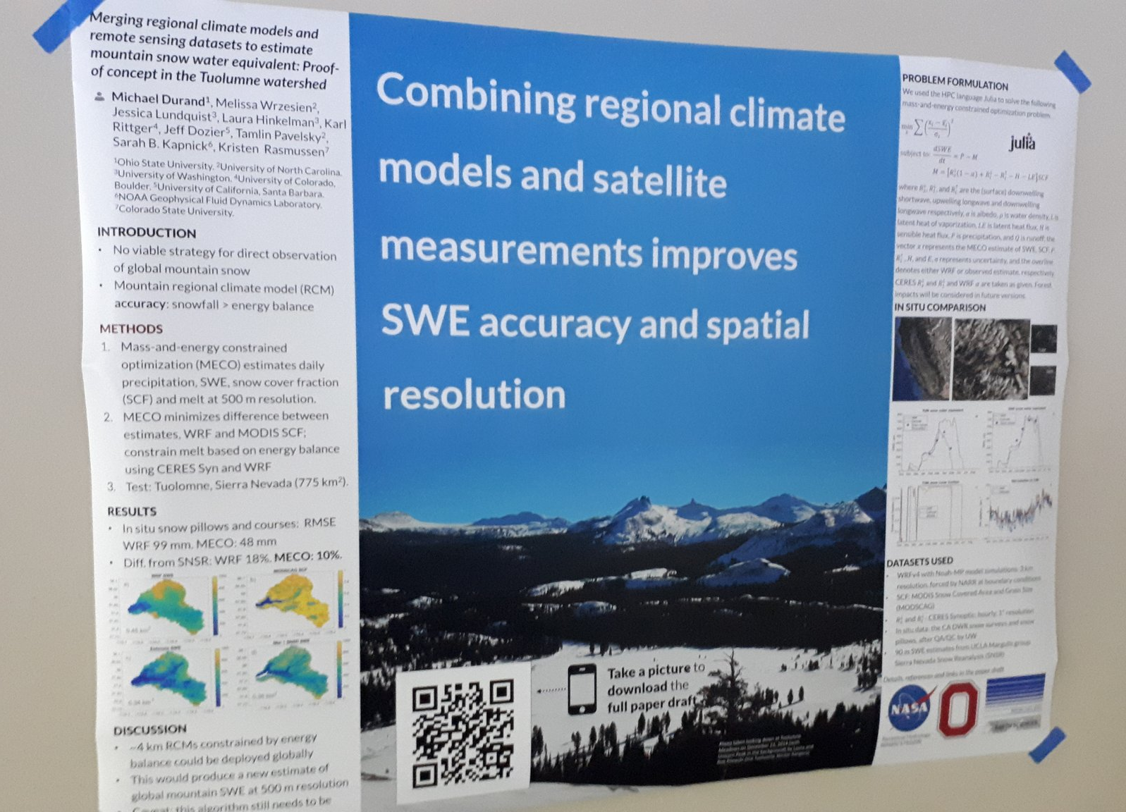
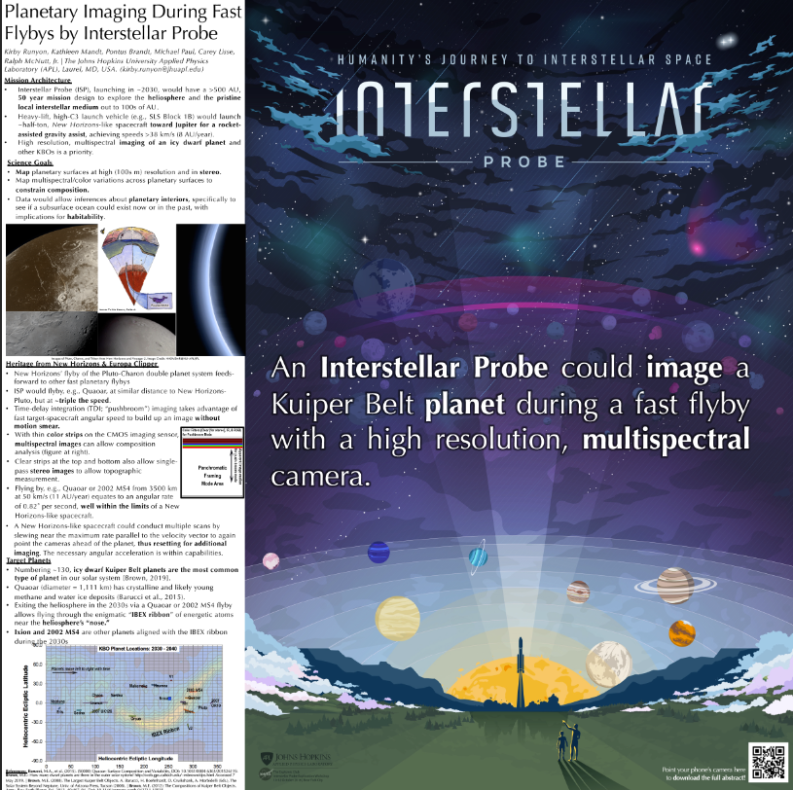
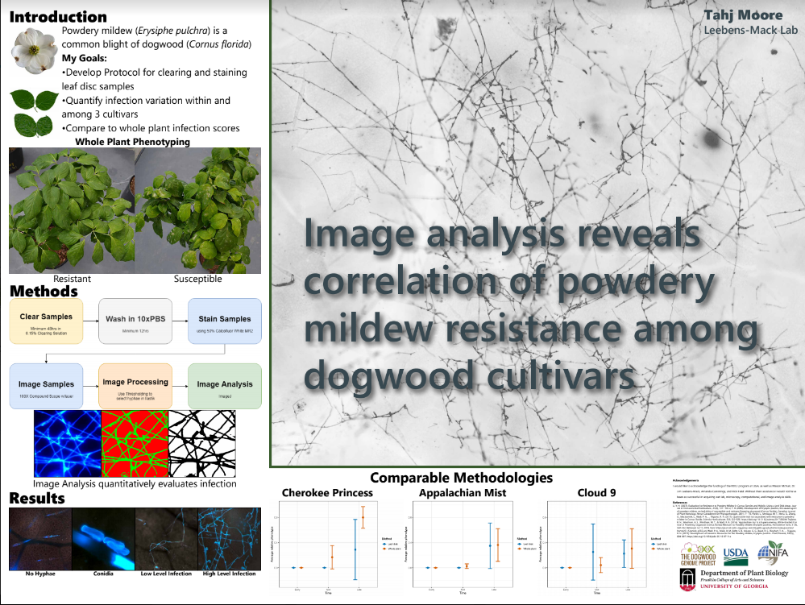
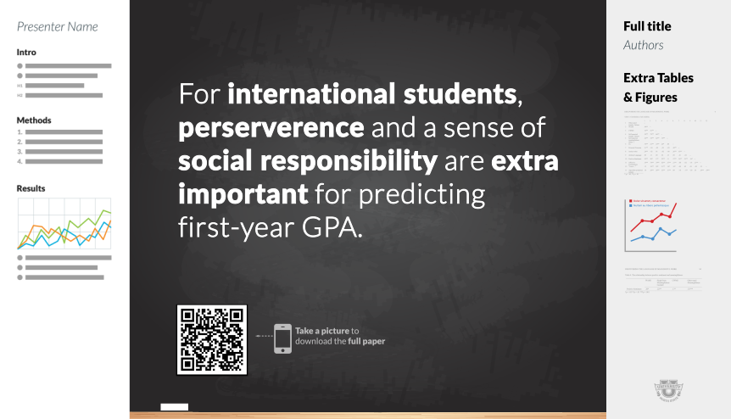

Try an on-theme background.
Add fun and reinforce your study’s context, but make sure to keep a high contrast between your text and background!
Example donated by @brenden0walker
Example donated by @hydrogawker
Mountain photo by @mnthydro
Example donated by @nasaman58
vvv
Example donated by @SarraceniaMason
Example donated by @americoamorim
Example by @mikemorrison

Slide 9
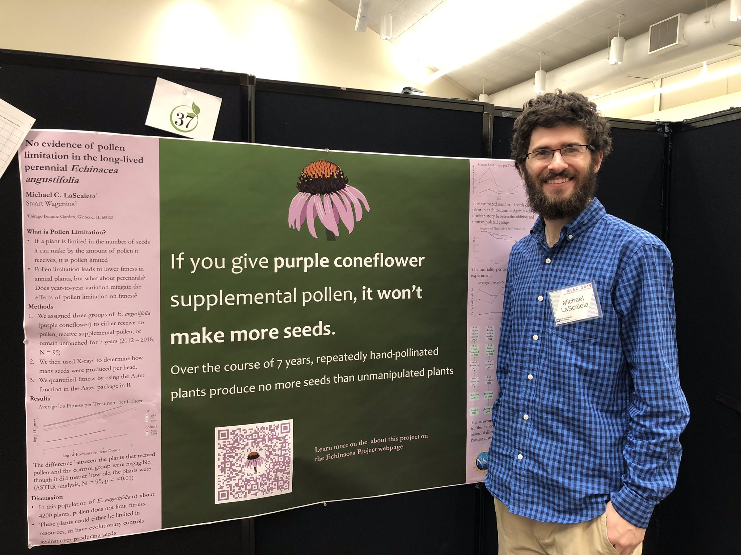
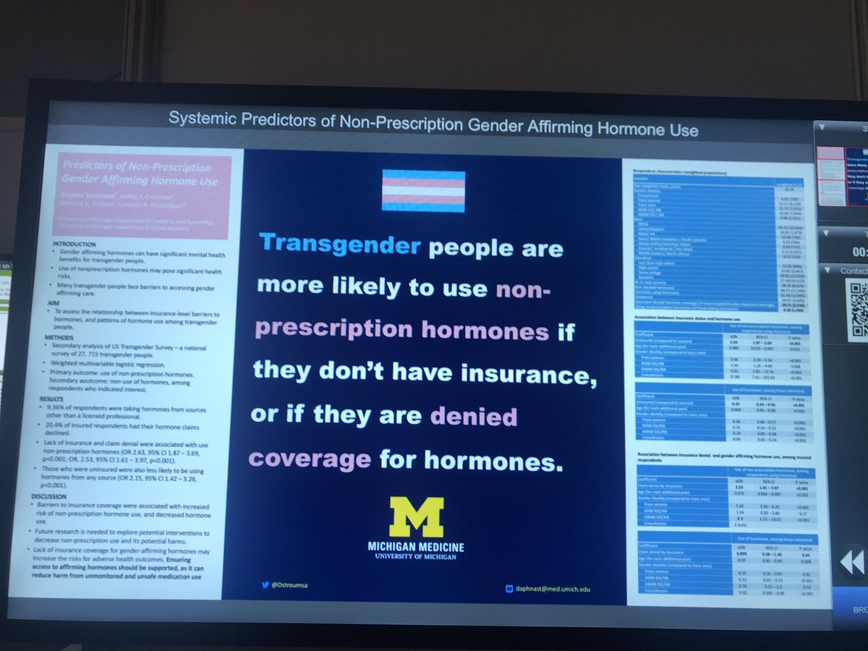
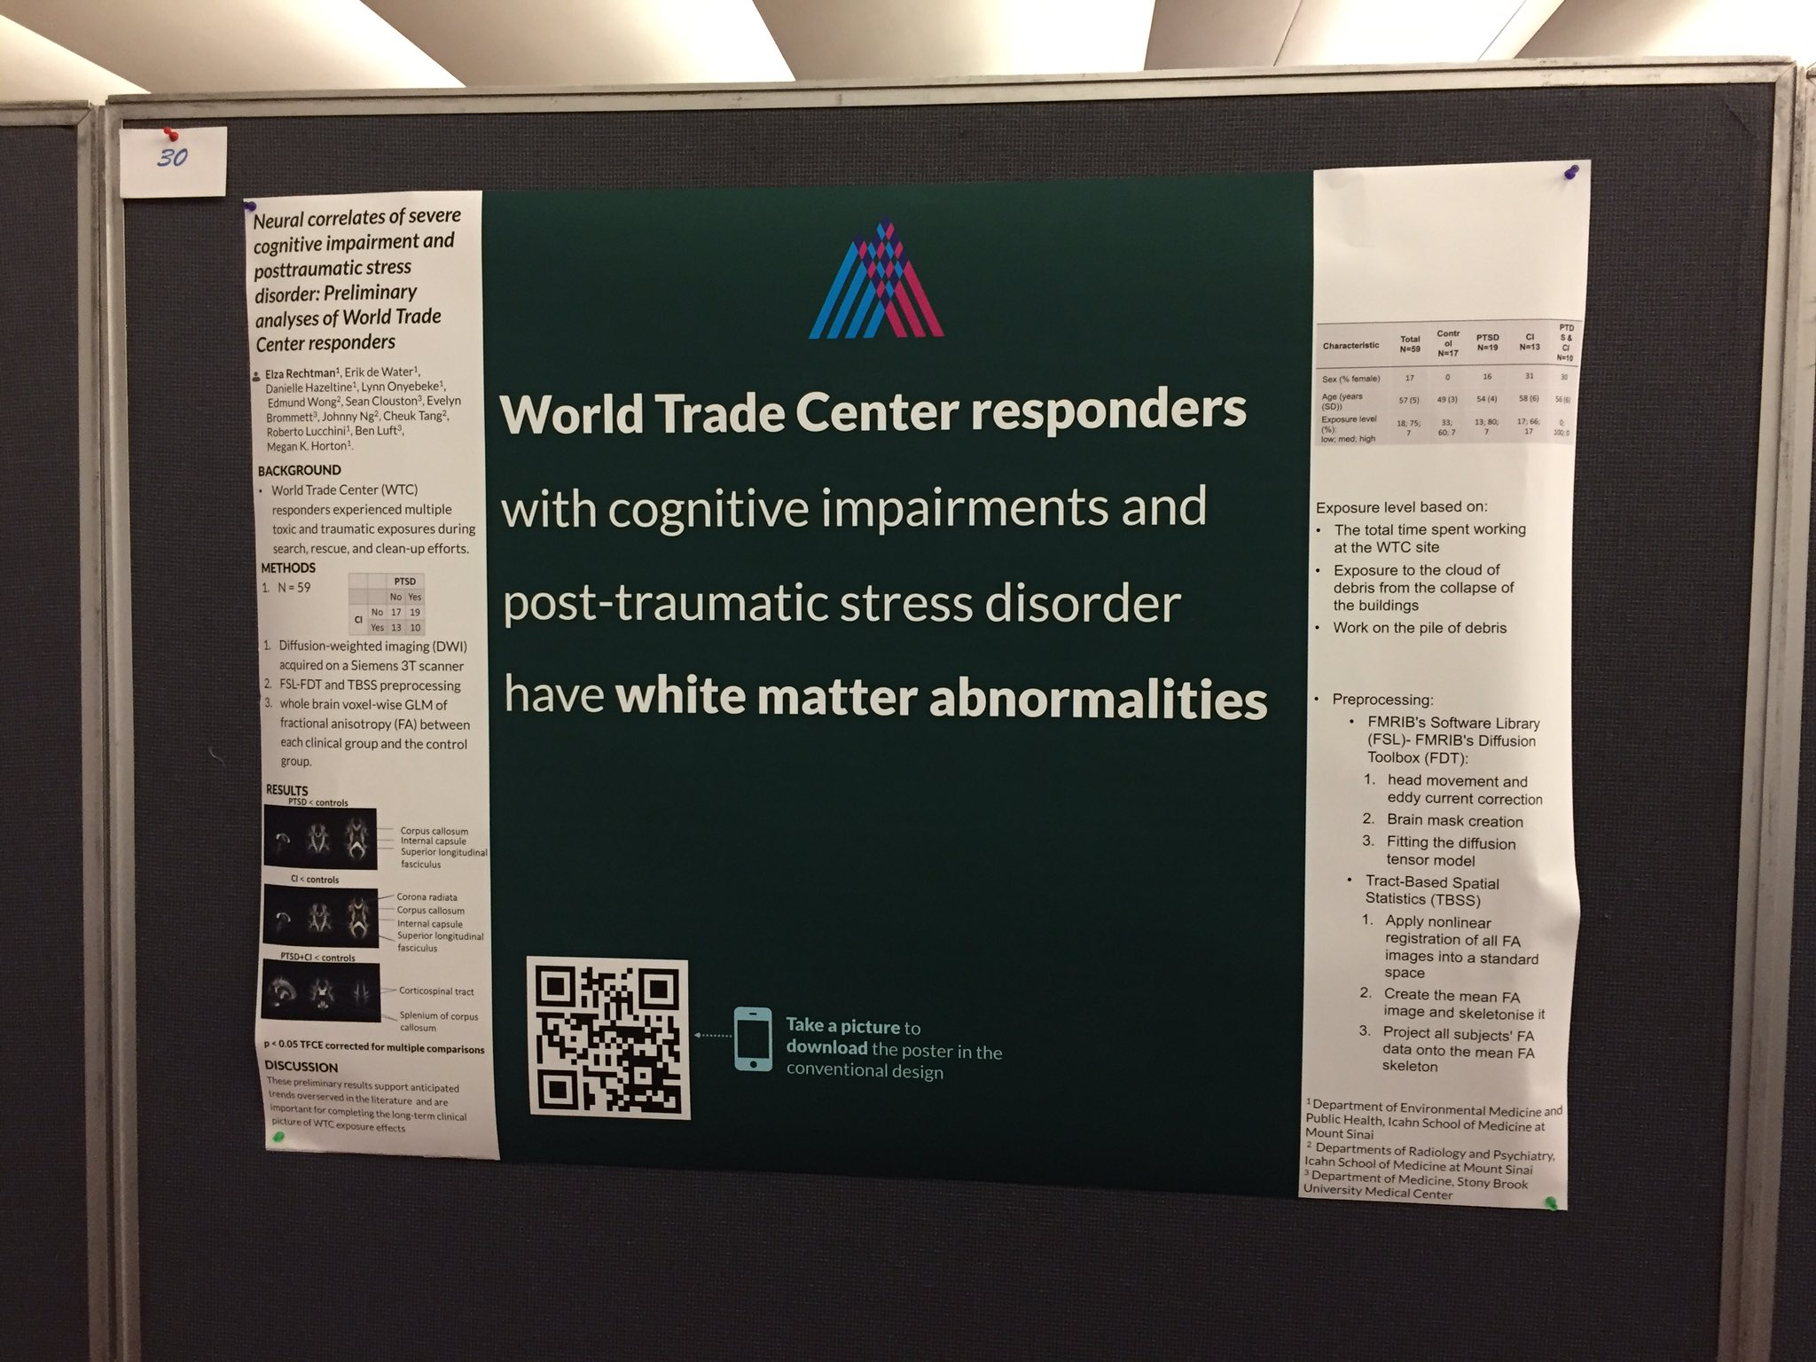
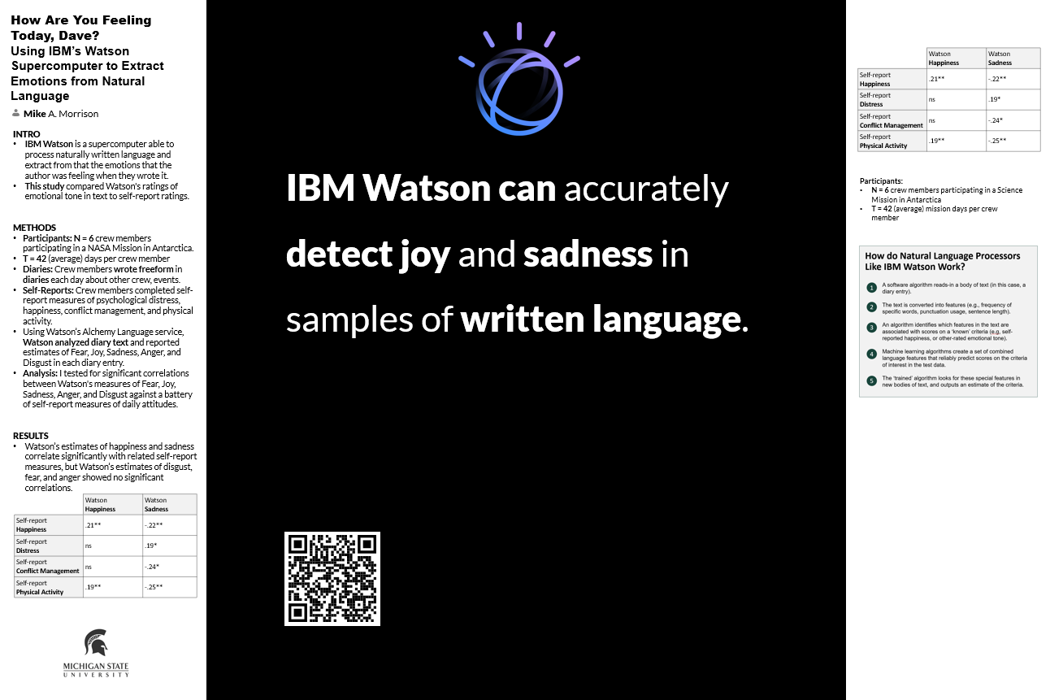
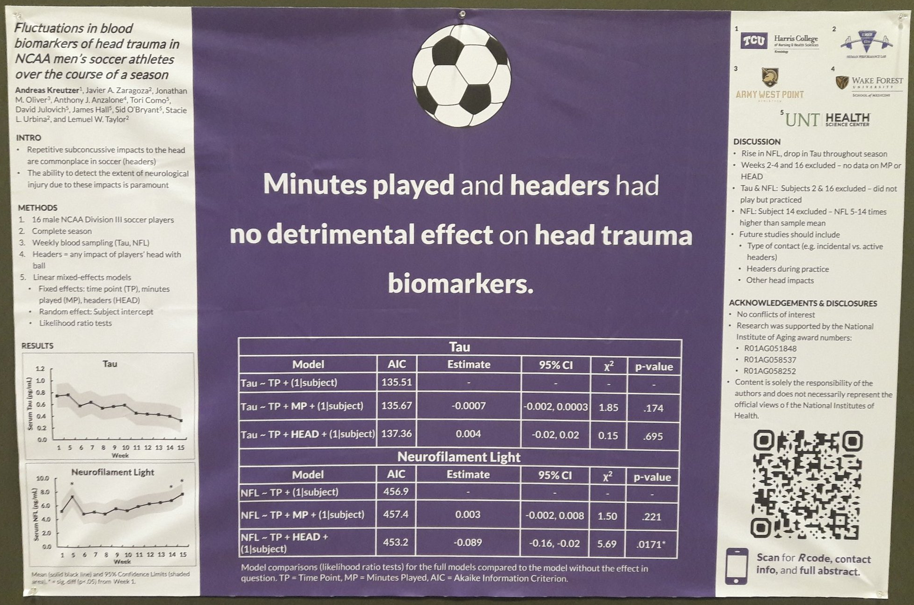
Try a ‘hat’ icon.
Fun, reinforces your finding, makes your poster memorable
— and can be interpreted at-a-glance.
Example donated by @MCLaScience
Example donated by @DStroumsa
Example donated by @ElzaRechtman
Example donated by @mikemorrison
Example donated by @akreutzer82

Slide 10
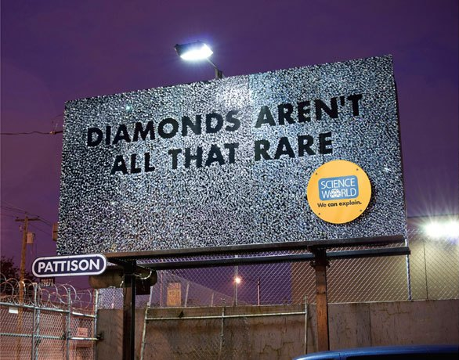
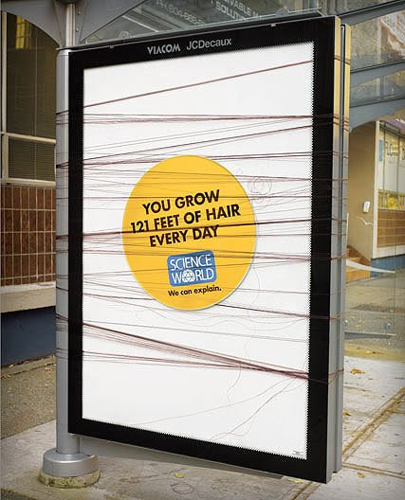
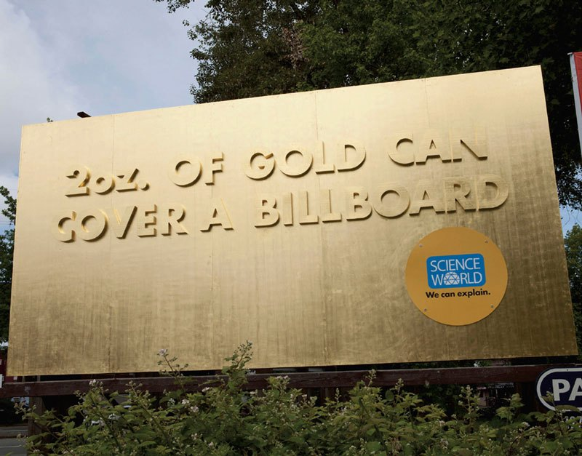
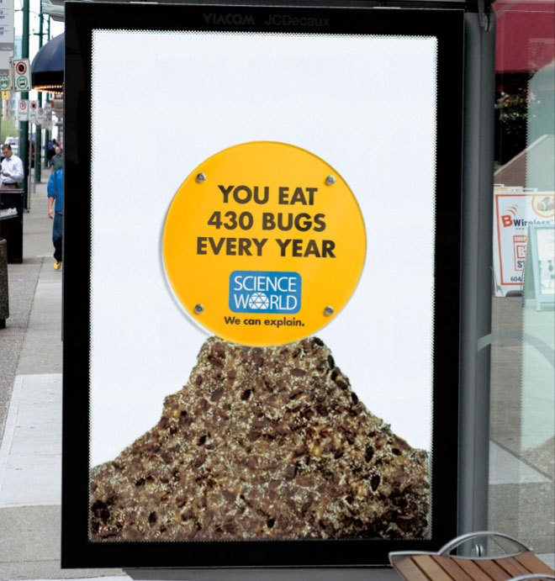
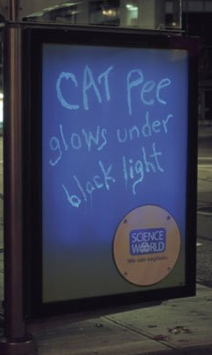
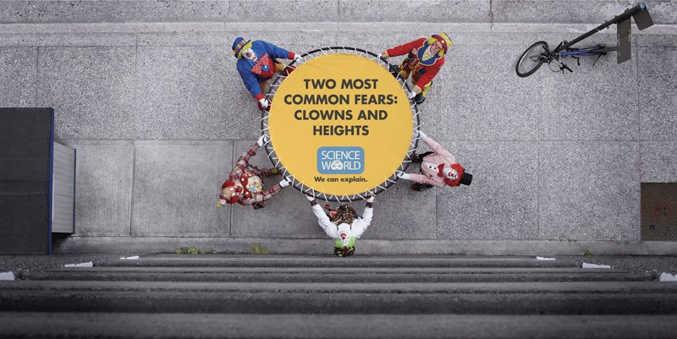
Here are some memorable science billboards for inspiration.
Ctrl+Click here for more.

Slide 11
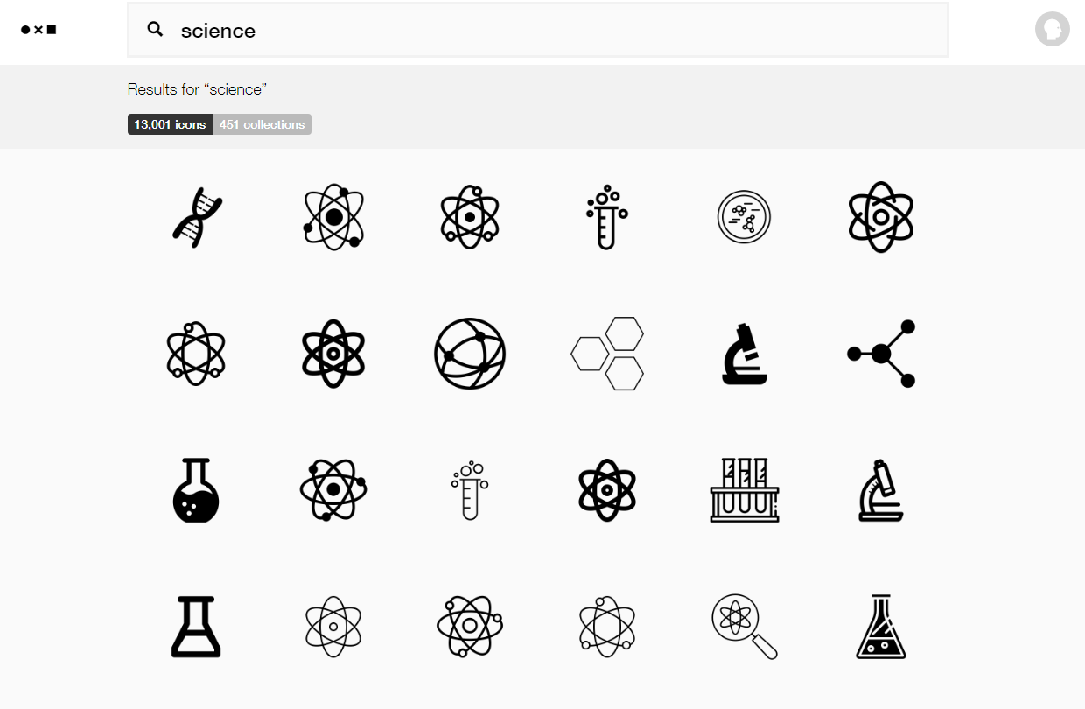
You can get free icons from
TheNounProject.com
https://thenounproject.com

Slide 12
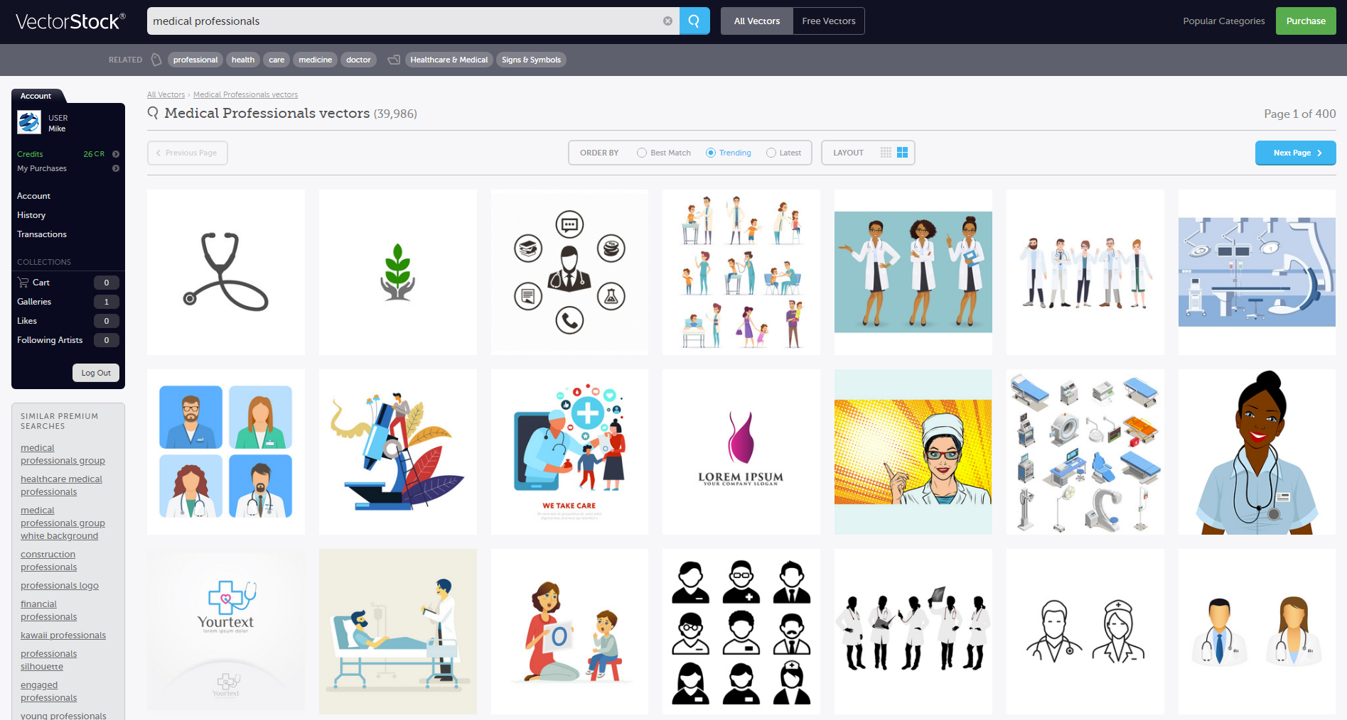
Get full-color graphics on a transparent background for ~$1/each from…
VectorStock.com
https://vectorstock.com

Slide 13
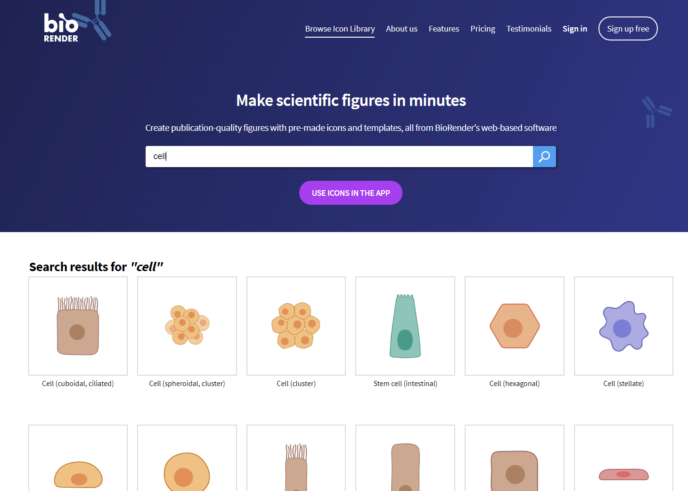
You can create biology figures with
BioRender.com
http://BioRender.com

Slide 14
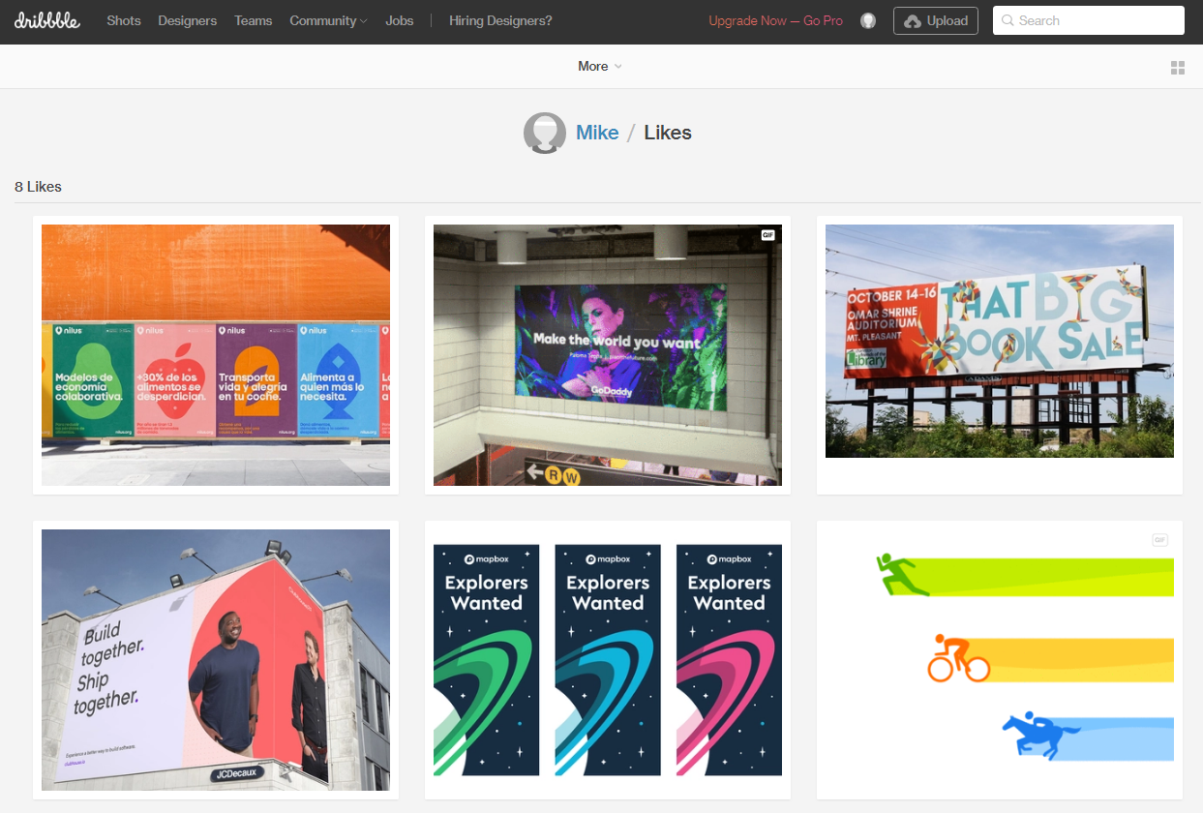
Stuck on a design dilemma? Do what other designers do! Go to dribbble.com and scroll through stuff until a solution jumps out at you. Try searching for “posters” or “graph”.
https://dribbble.com/

Slide 15
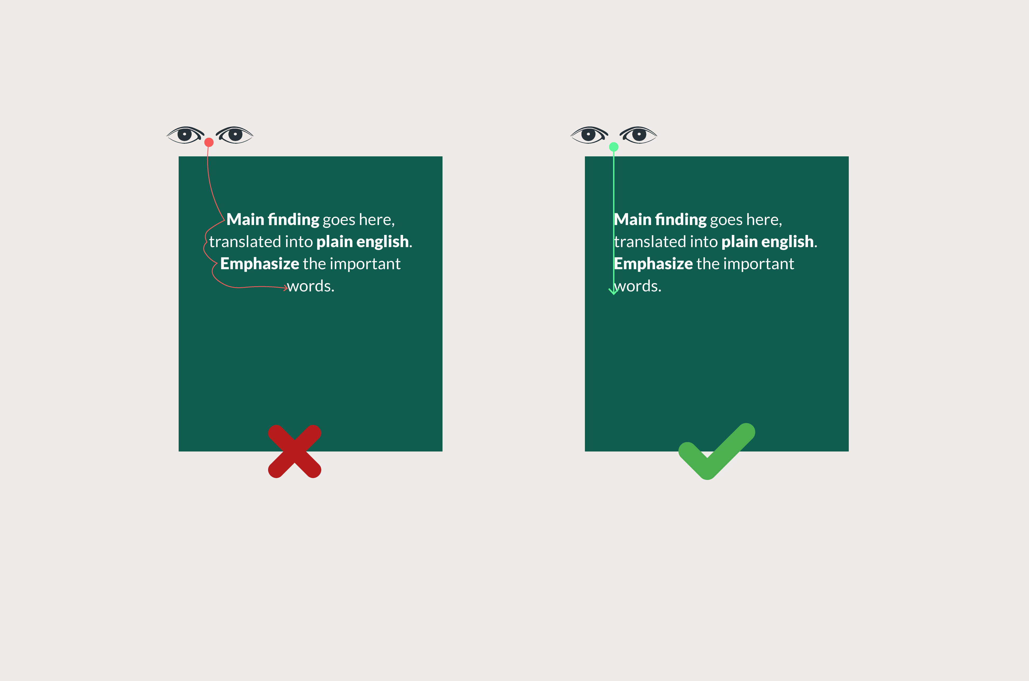
If your punchline is more than 2 lines, don’t center it. Centered text is slower to read than left-aligned text.

Slide 16
Gallery
Real posters designed based off of the main templates.

Slide 17
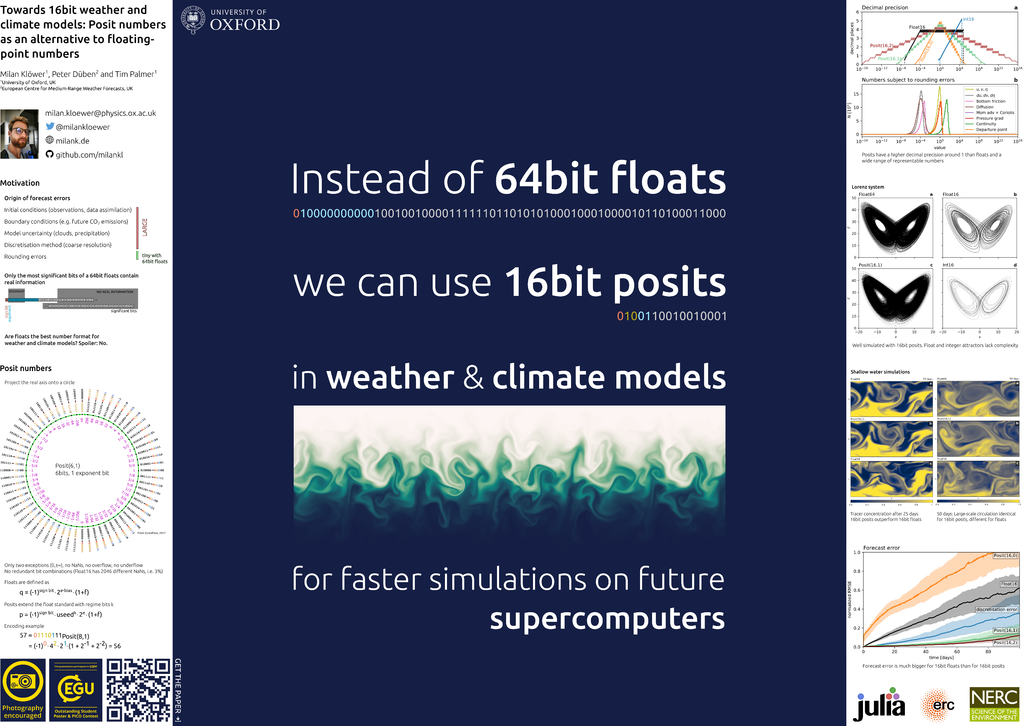
Example donated by @milankloewer
http://www.milank.de/documents/kloewer_egu.pdf

Slide 18
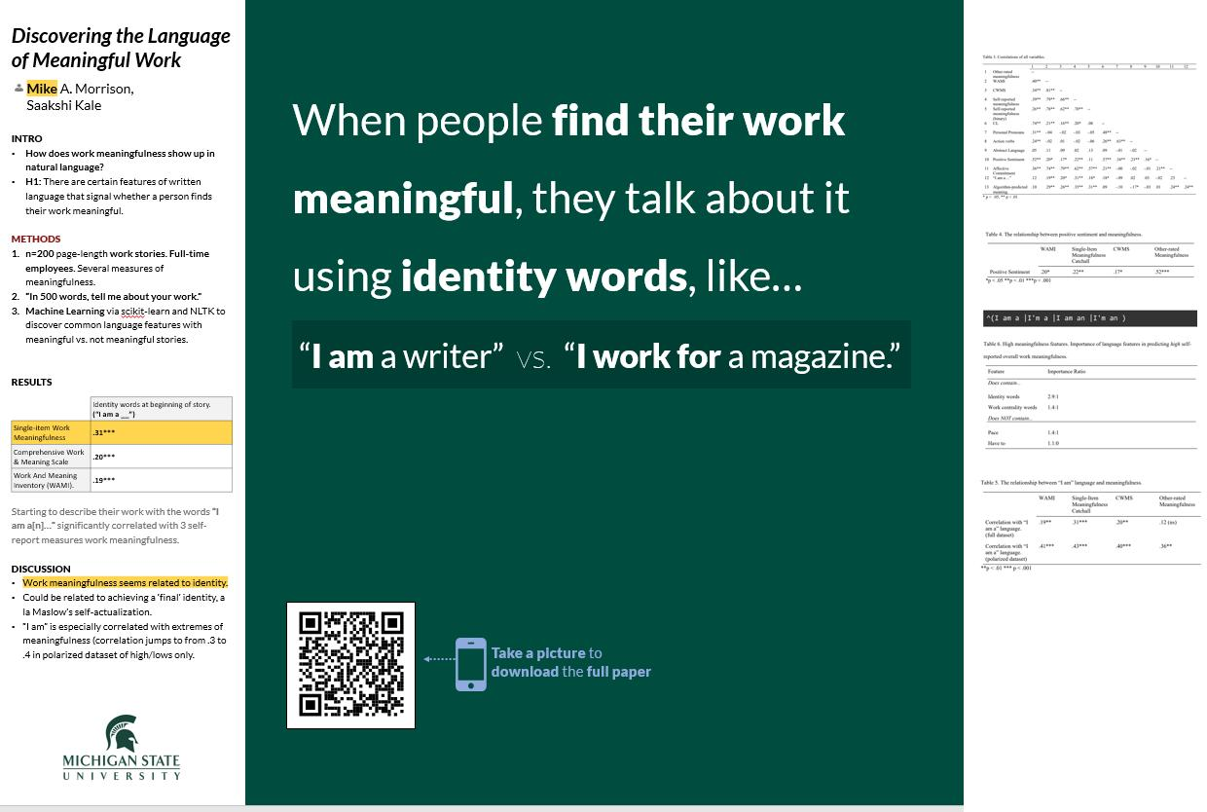
Example by @mikemorrison

Slide 19
Example by @jesshlay

Slide 20
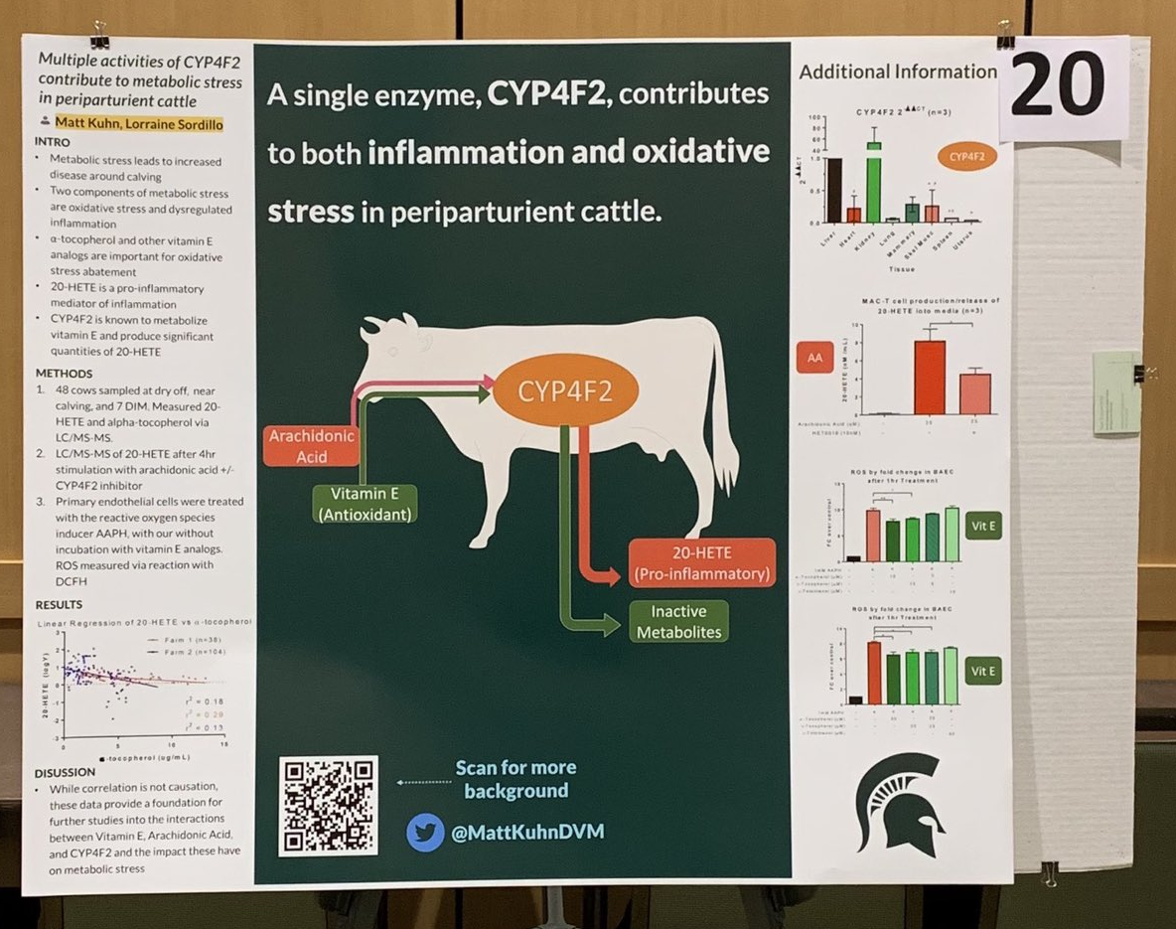
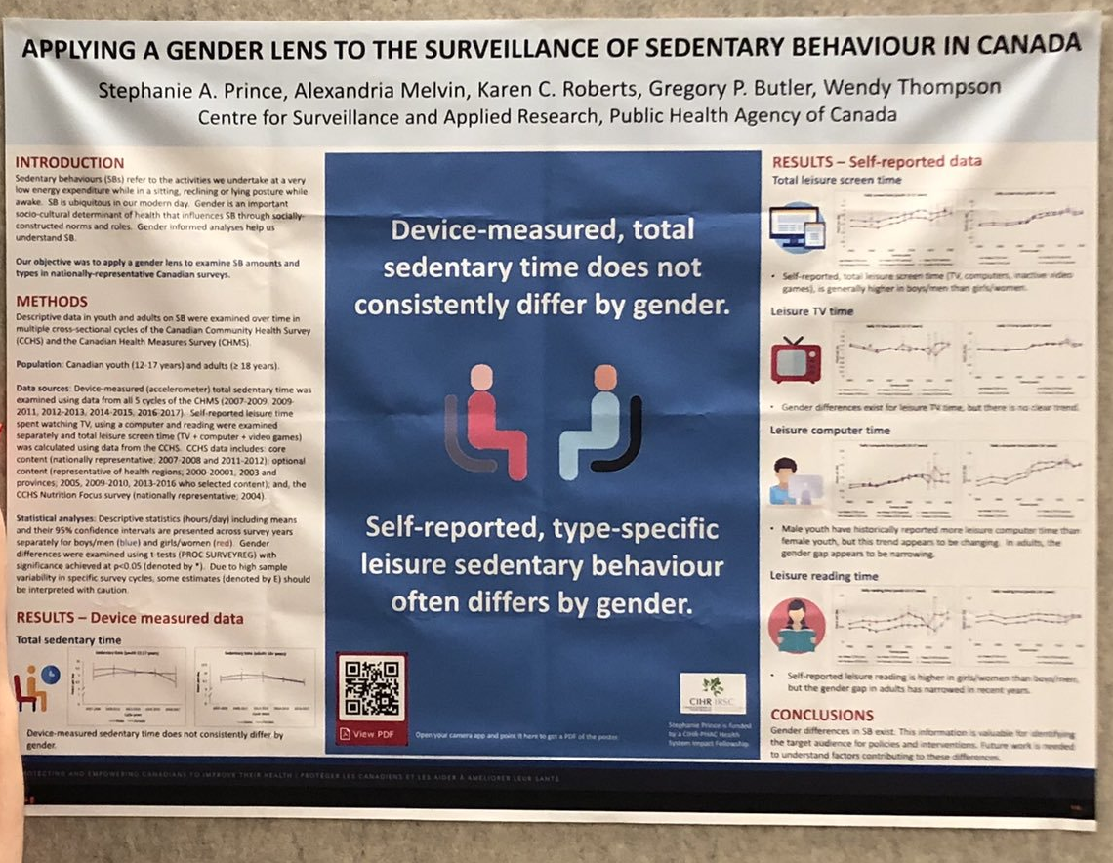
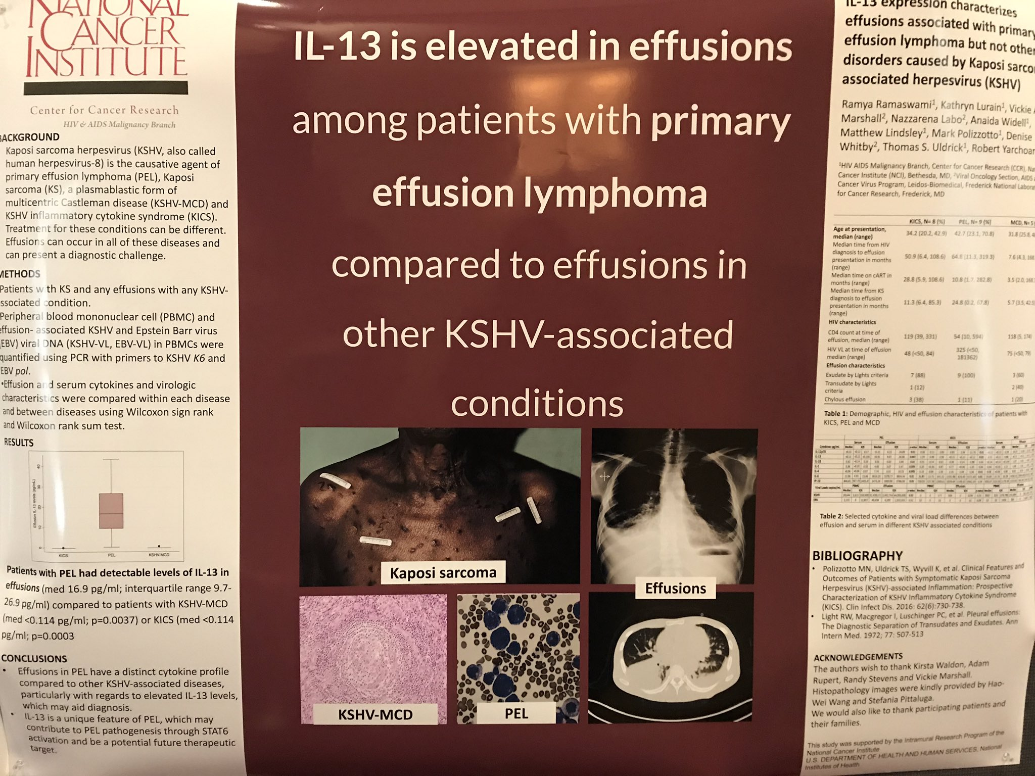
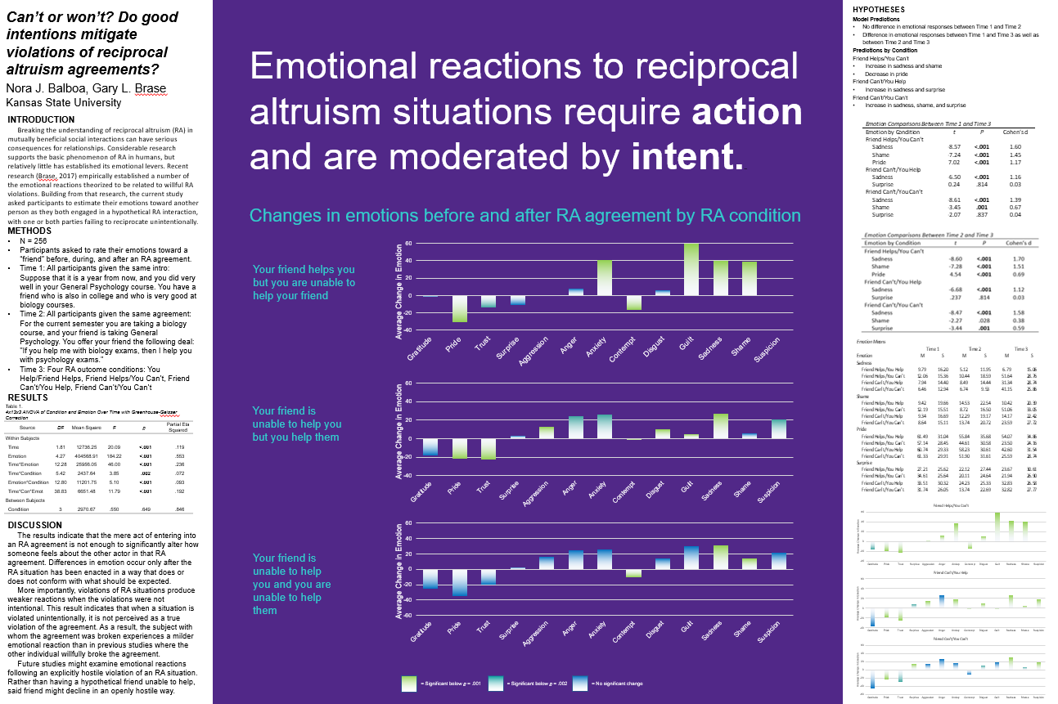
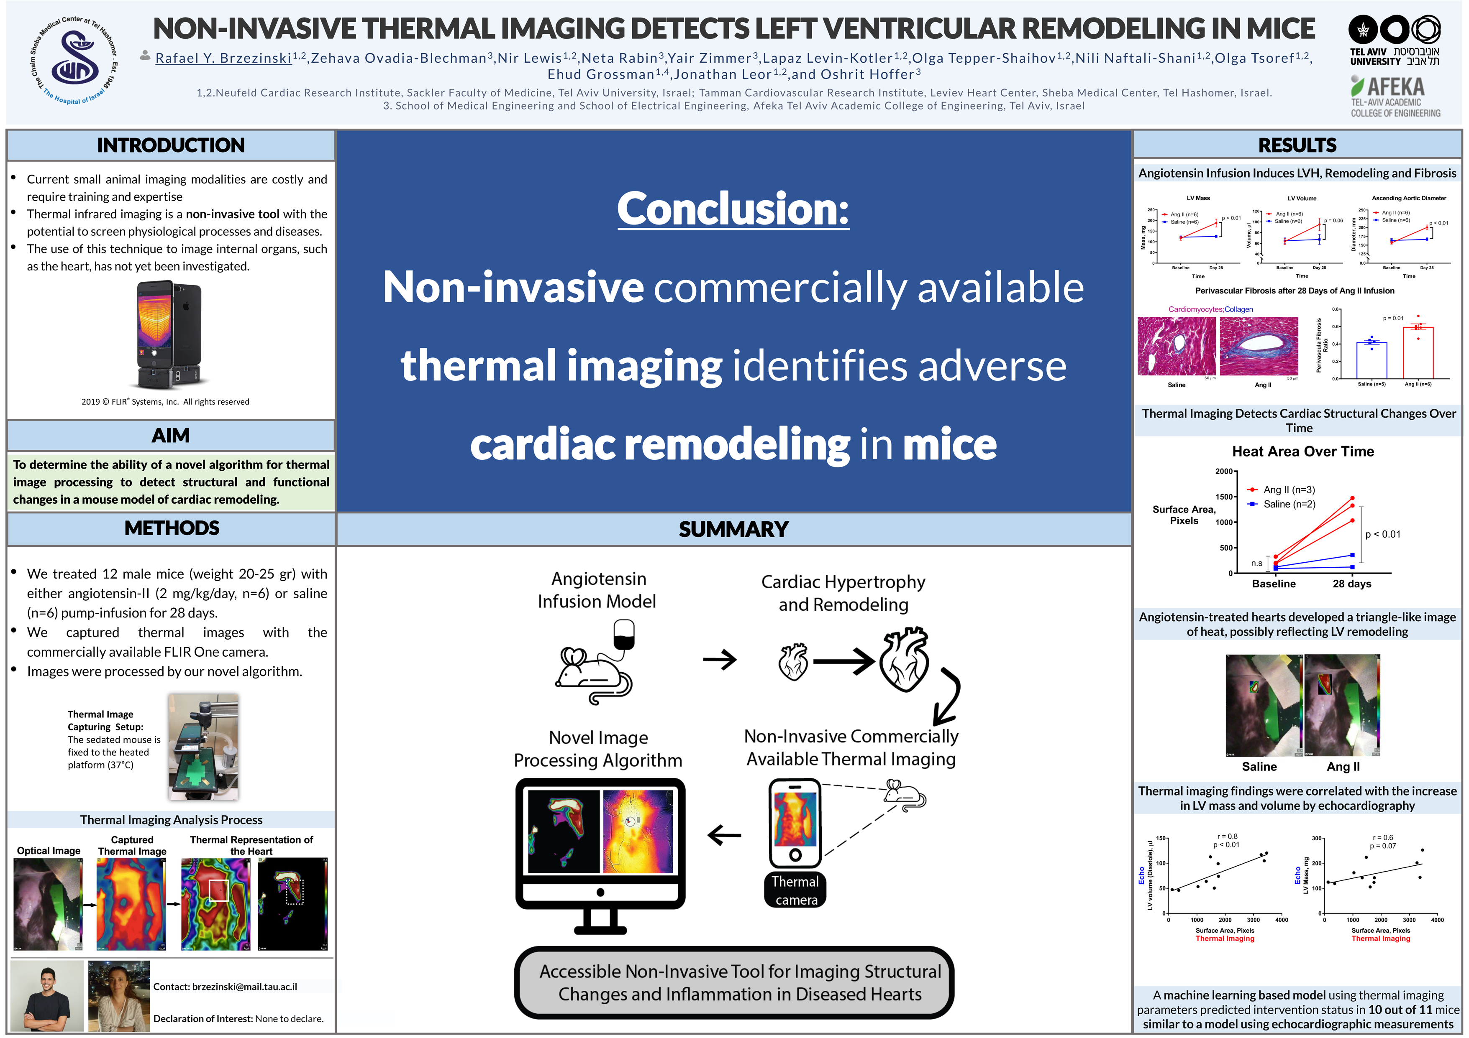
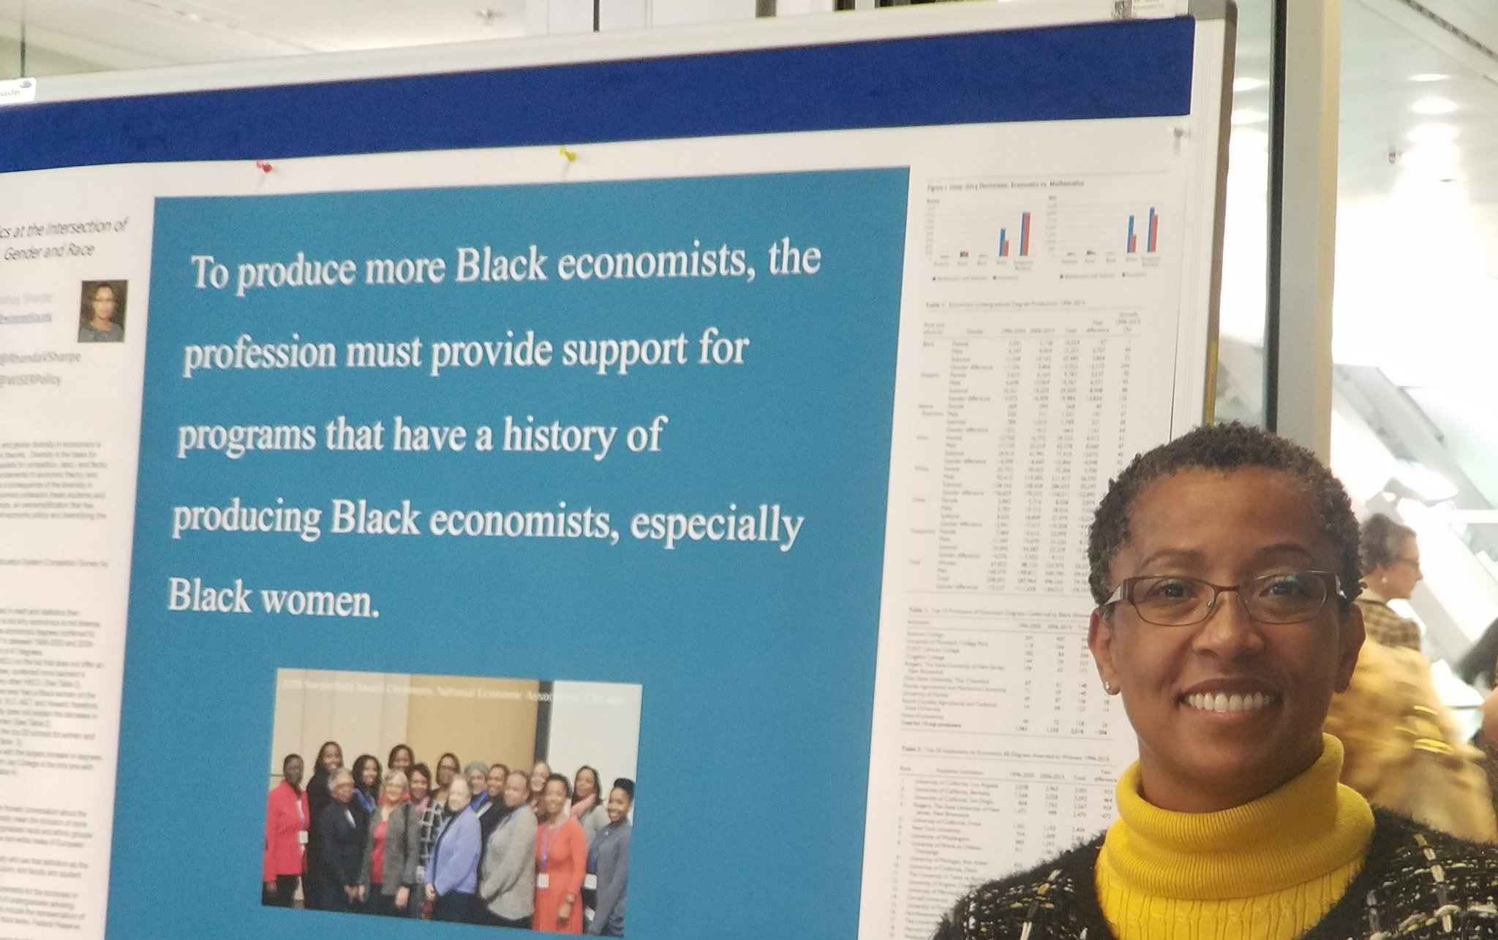
Example donated by @MattKuhnDVM
Example donated by @SPrinceWare
Example donated by @ramya_ramaswami
Example donated by @NoraBalboa
Example donated by @BrzezinskiRafi
Example donated by @RhondaVSharpe

Slide 21
Mods
Community-submitted modifications that you can edit.
Make them your own!

Slide 22
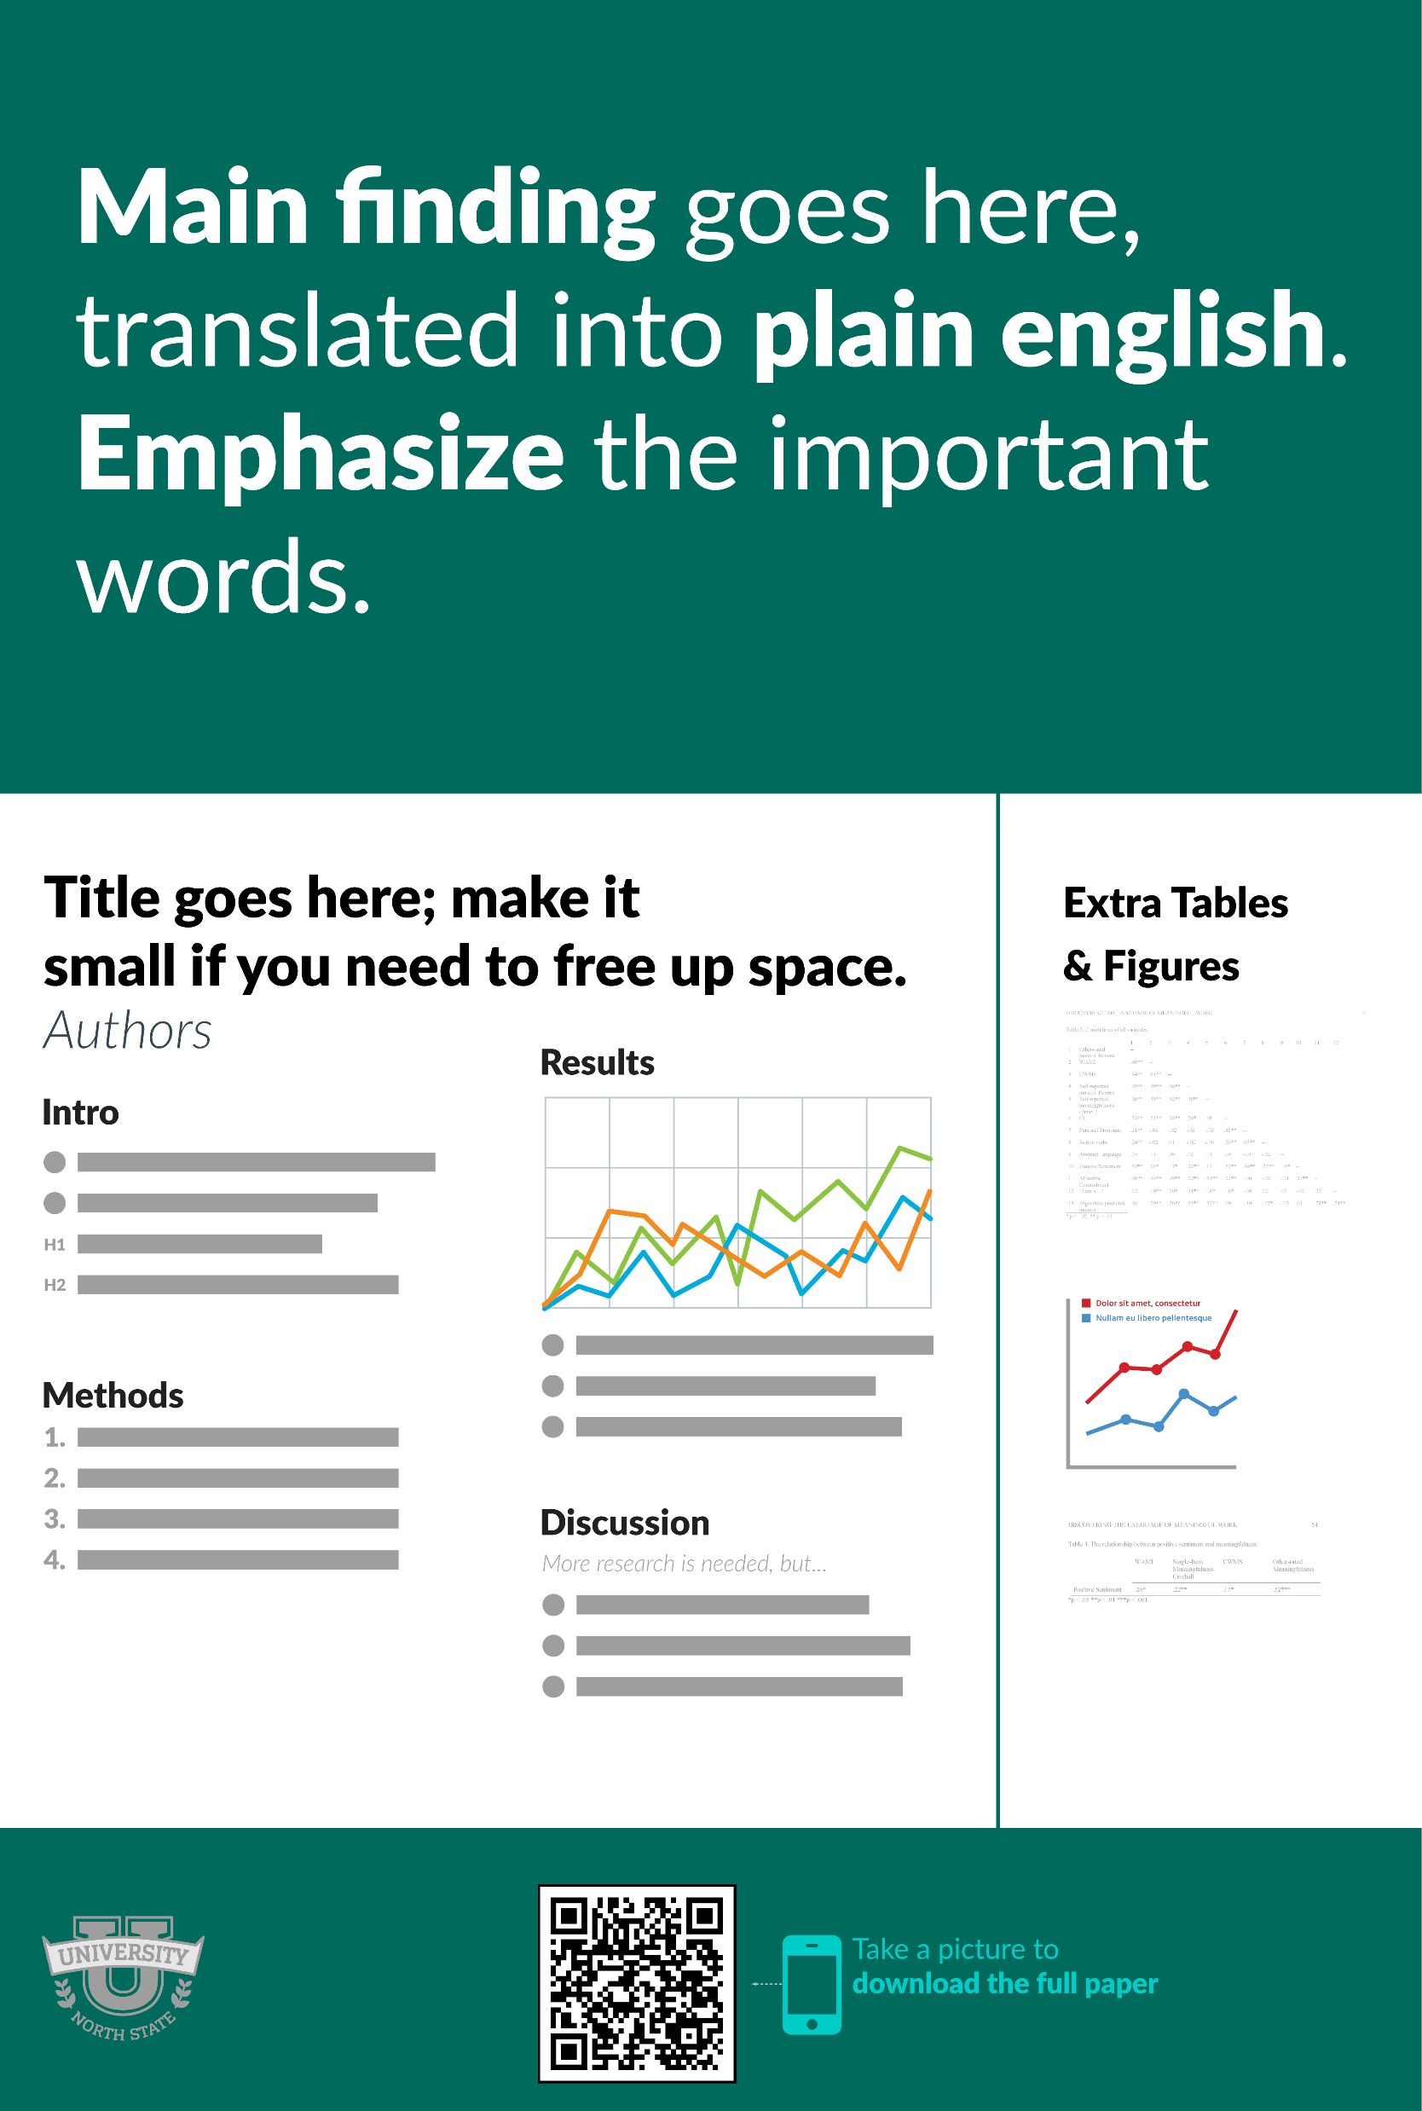
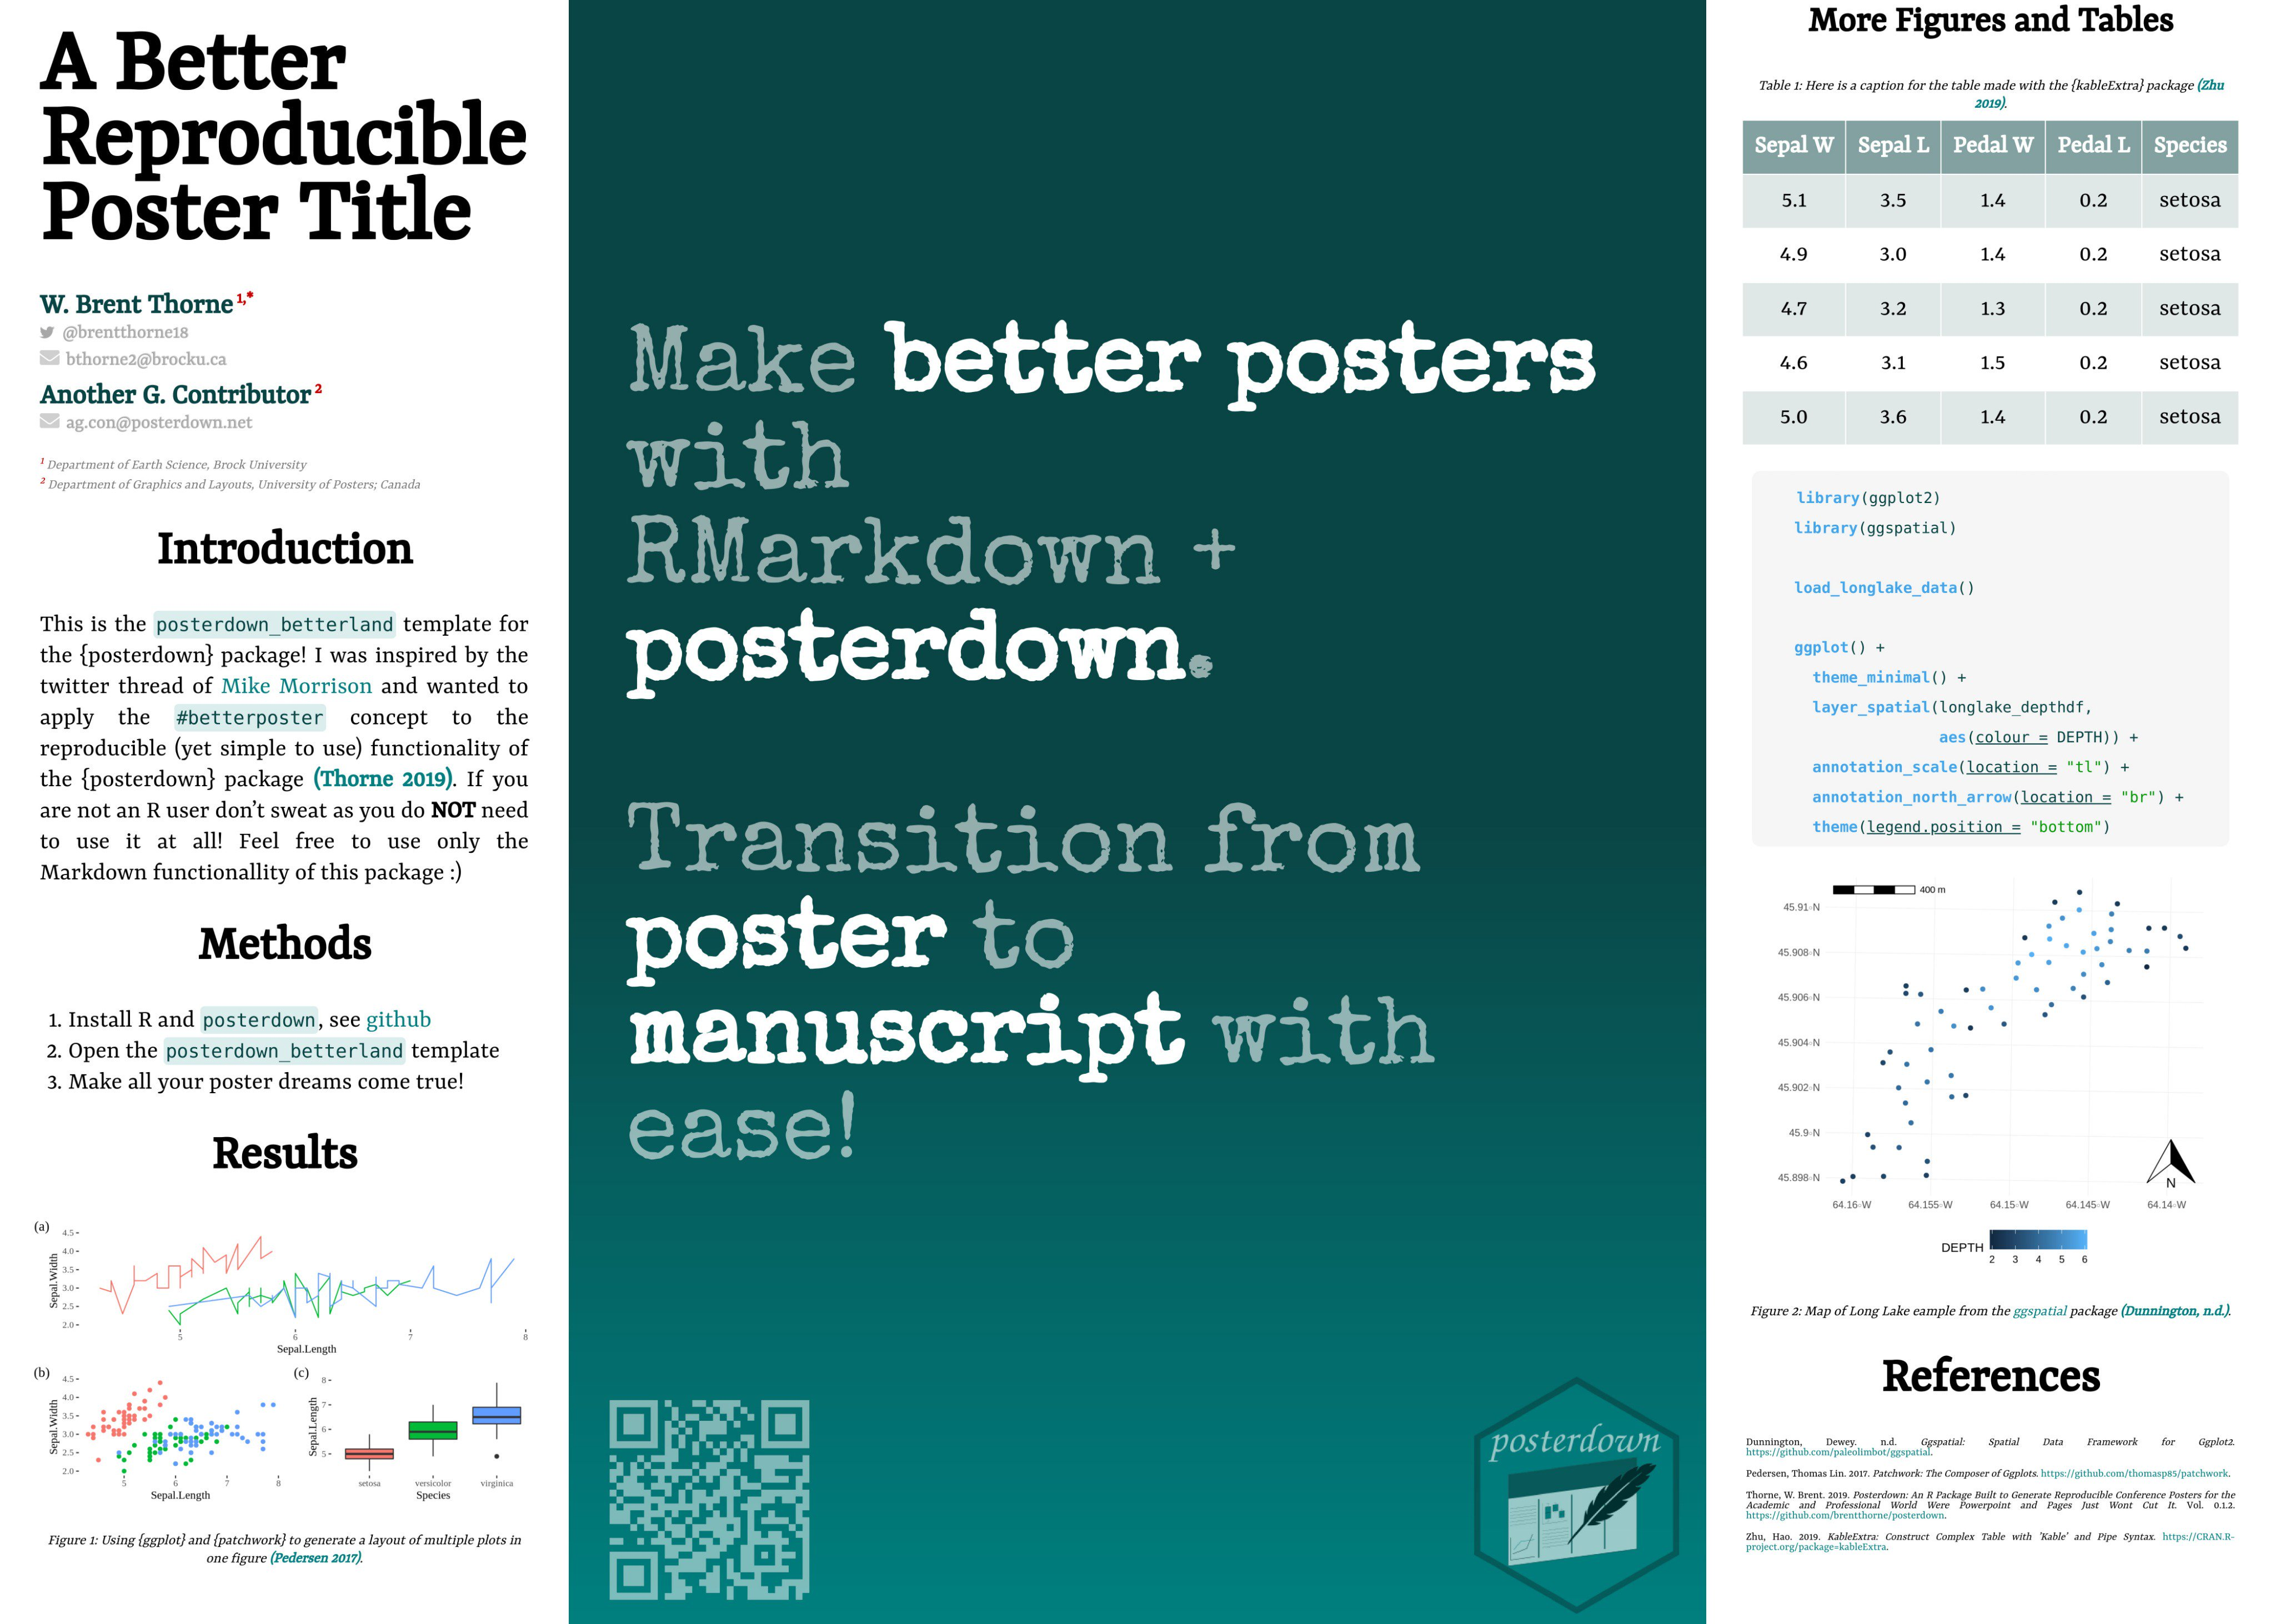

Portrait Orientation
https://osf.io/g6xsm/
R/Markdown Template
https://t.co/UsW4crrPZO?amp=1
by @mikemorrison
by @brentthorne18
Reproducible (LIVE) HTML poster (e.g., moving GIFs if you're into that)
Printable to PDF
Supports google fonts
Click for full features list…

Slide 23

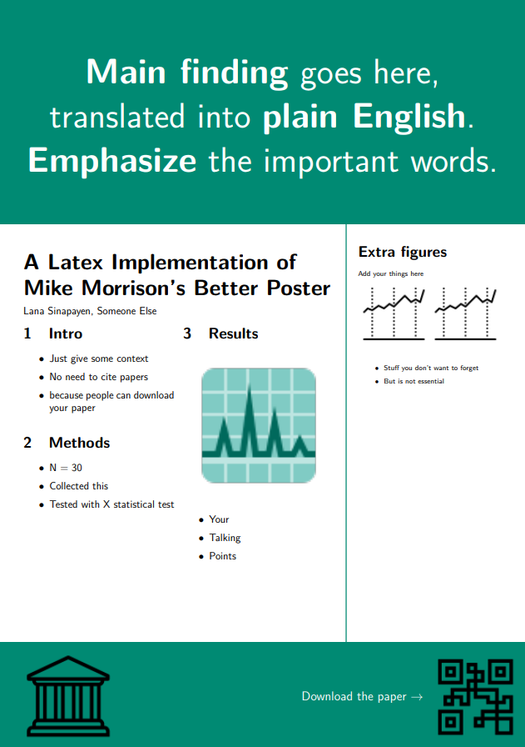
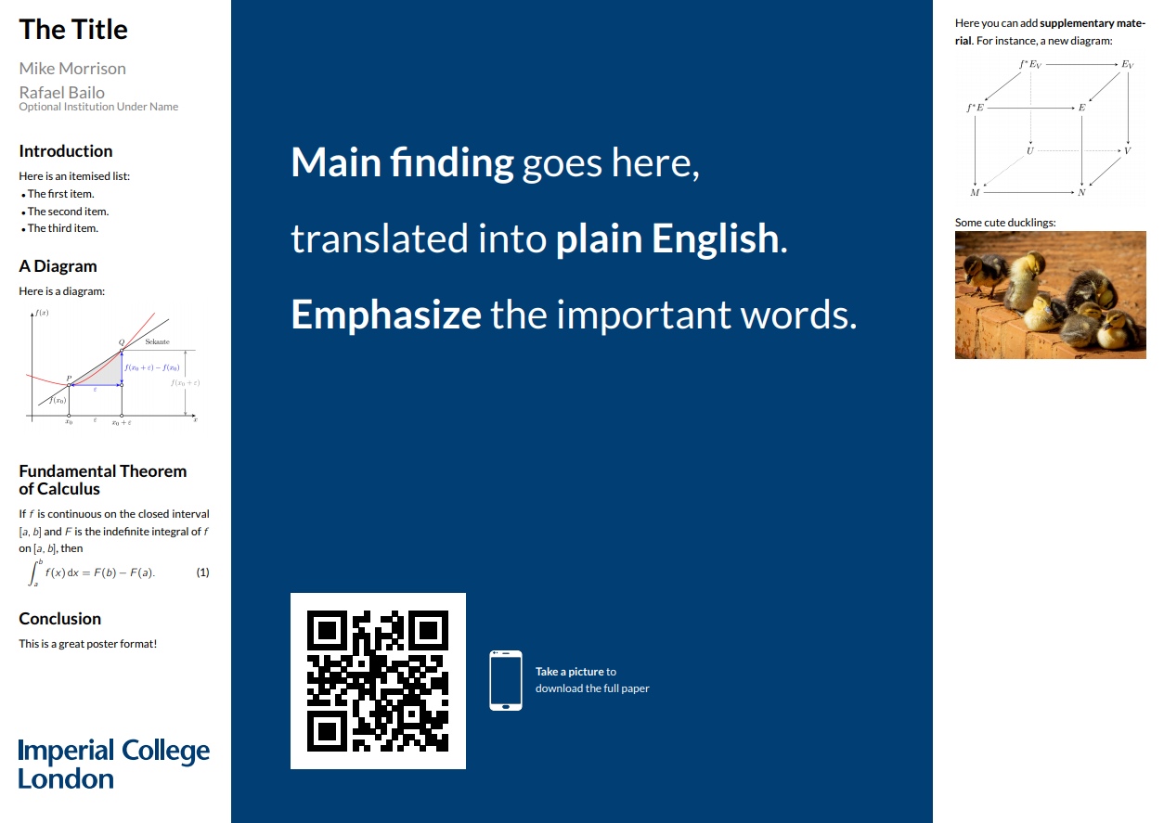
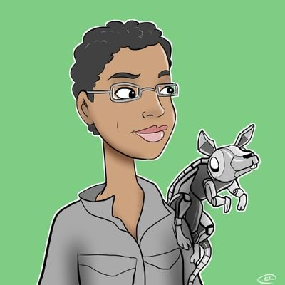


Templates
Portrait
Landscape
by @sina_lana
by @rtsbailo
Download
(Ctrl/Cmd + Click)
Download
(Ctrl/Cmd + Click)
https://github.com/LanaSina/better_poster_latex
https://www.overleaf.com/latex/templates/better-poster-latex-template/gmkgjvxqbyyt

Slide 24




Translations
v
v
Traditional Chinese
Simplified Chinese
Landscape
https://osf.io/td9sp/
Portrait
https://osf.io/nk8gh/
Landscape
https://osf.io/3dfwa/
Portrait
https://osf.io/n3e8x/

Slide 25
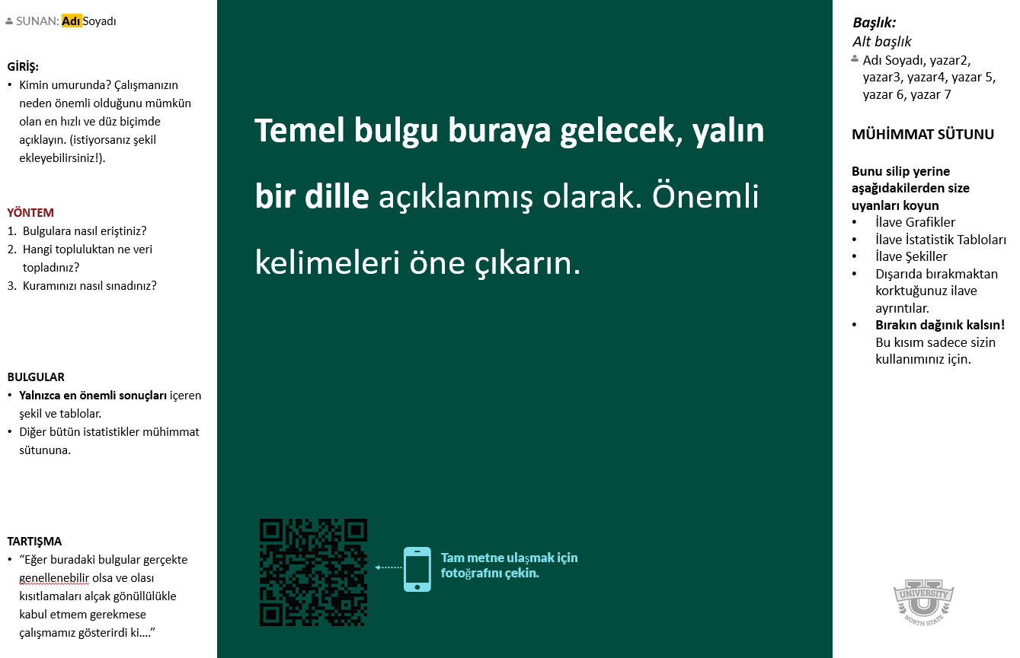
More Translations
v
Turkish
Landscape
https://osf.io/ck68a/
Special thanks to Mehmet Döke for the Turkish translation.

Slide 26
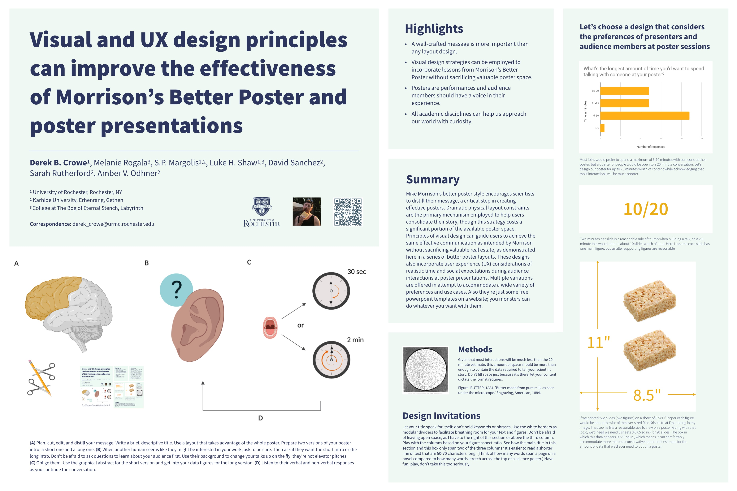
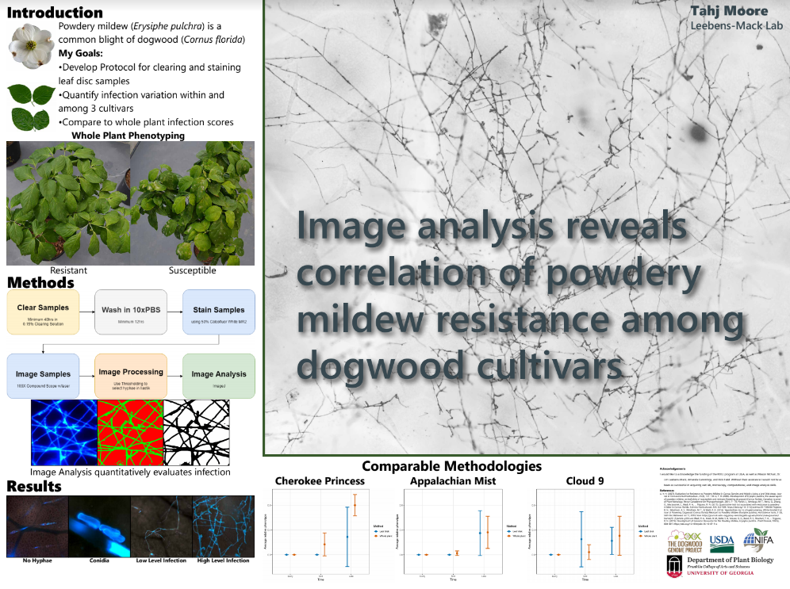
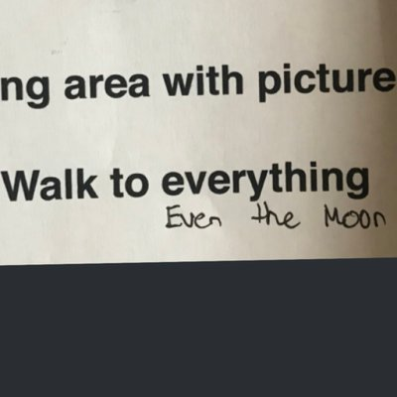

#butterposter
The “L” layout
by @derektoplasm
by @SarraceniaMason
Get templates from https://derekcrowe.net/butterposter
Adobe InDesign templates here: https://osf.io/zkmvw/

Slide 27


Why must we pick sides?
The new poster format is a revolution, or the new poster format is garbage!
Take the good parts of the new format, keep the useful aspects of the traditional format, add in your own ideas, and create something better.
We Don’t Have to Pick a Side: The Middle Is A Fine Place to Be
Andrew R. Smith
Appalachian State University
INTRODUCTION
Mike Morrison created a template for a “Better Scientific Poster” (BSP) (https://osf.io/ef53g/)
The BSP format has been praised by many, yet disparaged by others.
The current project had 2 goals:
Create a template that I think could be useful.
Point out that we don’t need to either love or hate the new format—the middle is just fine.
METHOD
To create a new template, I identified strengths of the BSP template and the traditional format.
BSP strengths: clear take-away message, minimal text, QR code
Traditional format strengths: room for figures, reasonable text size on sides, large title to make finding posters in poster session easy, web link and email for people who don’t like QR codes
RESULTS
Preregistered analysis: 78% increase in liking compared to traditional format and 24% increase compared to the BSP format.
Exploratory analysis: room for improvement in this template (Arial font, seriously?!?!).
DISCUSSION
Sometimes it makes sense to pick a side; this is not one of those times.
Praise what you like, make suggestions for improvement, and then make something better.
Take Mike’s ideas, incorporate some of mine, be creative, and let’s make posters more useful.
Poster template: https://osf.io/ayjzg/
smithar3@appstate.edu
Notes:
Notes:
In Powerpoint, click View > Guides
Keep text within gutter guides.
Author list: Don’t split names onto two lines (e.g., “Jimmy [break] Smith”). If that happens, use a new line, unless you need the space. Bold the first names of anybody who’s presenting in person.
Intro/methods/result: Do not drop below font size 28, but if you have extra space, jack up the font size until the space is full.
Do not use color in the sidebars except in graphs/figures. It’ll pull attention from the center and slow interpretation for passersby.

Slide 28



How to QR Code
How do I create a QR code?
https://www.qrcode-monkey.com/ is free, URLs don’t expire, and you can add cool features like images.
How do I scan a QR code?
Just pull out your phone and take a picture! All modern iPhones and most Android phones have built-in QR detection in their cameras. Some Android phones may need an app.
How can I link the QR to my paper and a copy of my poster and my contact details.
Try creating a multi-page link for free via https://linktr.ee/. (Still trying to figure out the best answer to this though.
Ctrl-click this thumbnail to watch a video on scanning #betterposter QR codes.
Donated by @kristinrojasmd
https://twitter.com/kristinrojasmd/status/1124418213050298368

Slide 29
Research that influenced this design: a.k.a “I need some ammo to help persuade my faculty to try this.”
1. Need to know > Nice to know
https://www.nngroup.com/articles/inverted-pyramid
2. Plain language is interpreted faster.
https://www.nngroup.com/videos/plain-language-for-experts/
https://www.nngroup.com/articles/plain-language-experts/
3. Interaction cost.
https://www.nngroup.com/articles/interaction-cost-definition/
4. Effective designs minimize cognitive load
https://www.nngroup.com/articles/minimize-cognitive-load/

Slide 30
Layout F.A.Q.
What if my intro/methods/results doesn’t fit in the silent bar?
If you’re trying to put so much into that bar that it doesn’t fit, they won’t have time to read it anyway. First try moving stuff to the ammo bar. Next, cut cut cut.
Instead of trying to fill space, you’re trying to conserve space.
What if I have a really important graph or picture?
Move the QR Code to the Silent Presenter, then put your graph/image in the middle.

Slide 31
How did you make the cartoon?
Short version: I highly recommend making a video using Vyond.com if it's your first one and you don't want to go insane for a year like I did. It’s fun, easy, and works perfectly well for most projects!
Animation: Most of the animation was done in Adobe After Effects, which is super powerful but had a bit of learning curve for me.
Graphics: A combination of VectorStock and custom graphics I made in Adobe Illustrator.
Characters were mostly from (http://Vyond.com) Vyond.com. I got the facial expressions, etc. right in Vyond, then put them on a green background, then dropped them into After Effects and removed the background, just like a green screen.
Sound effects: AudioJungle.
Voice was my own voice with the bass boosted for a little of that radio announcer vibration, courtesy of Adobe Audition.

Slide 32
Design isn’t about making things look pretty. It’s about directing attention.
Great design is subtle.
Design should feel like problem-solving.
UX designers feel a surge of happiness when they get to delete something.
When it looks too simple to represent the amount of time you put into it, you’re done.

